Slide 1

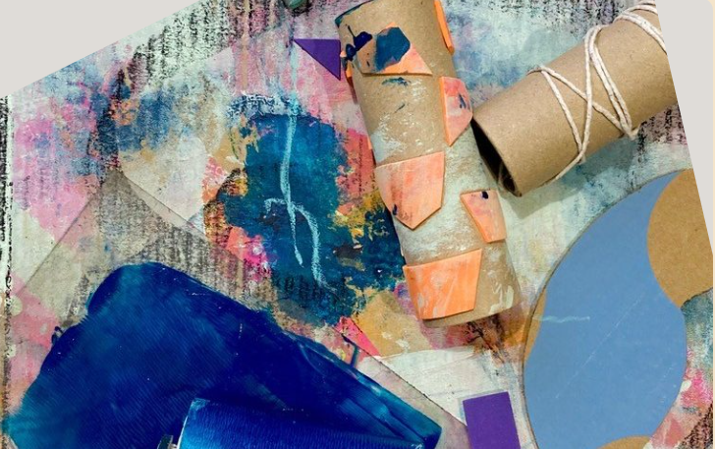
Pattern, Print and Play:
Enid Marx Exhibition Programme
EYFS & KS 1 & 2
Teacher’s Pack

Slide 2
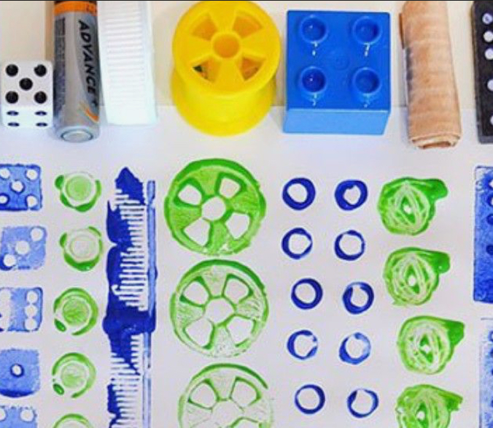
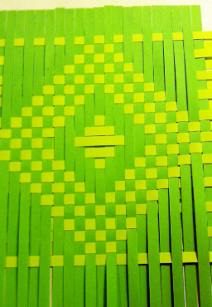
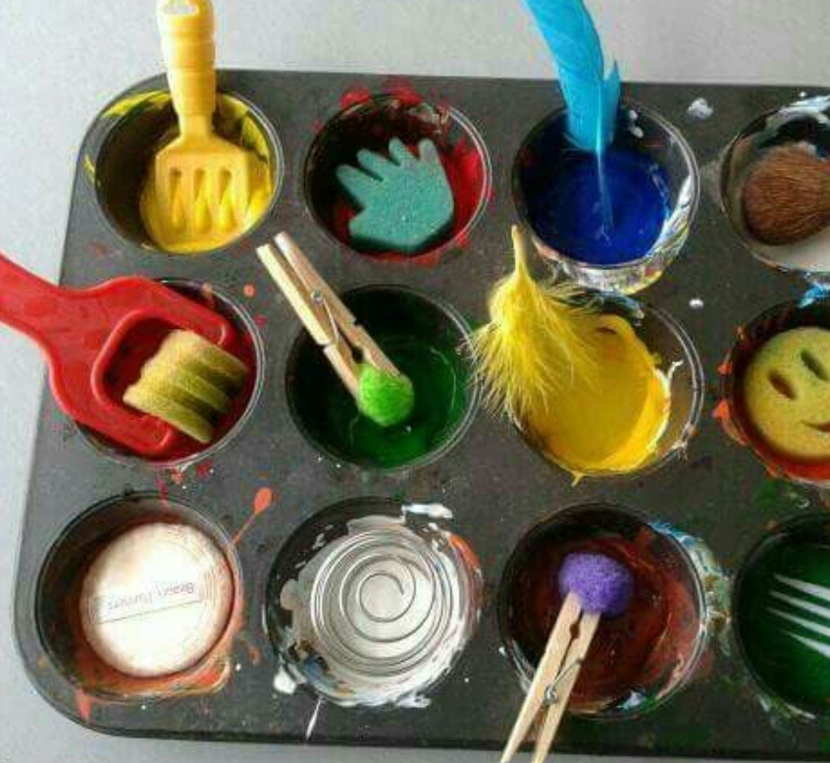
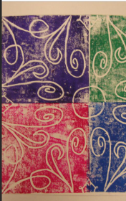
Contents
About the workshop
About Enid Marx
Learning outcomes and objectives
Itinerary
Top Tips for your visit

Slide 3
About the workshop
Students will visit Compton Verney’s Enid Marx exhibition, ‘The Pattern of Life: Enid Marx and Contemporary British Design’. They will explore pattern, texture and repetition through the textile work of Enid Marx, a pioneering designer celebrated for her bold geometric motifs, hand-printed fabrics and her iconic designs for London Underground seating.
In EYFS and KS1, students will discuss shapes, colours and patterns. They will take part in a carousel of activities where they will be encouraged to be curious, play and experiment with mark making using stamps, stickers, rollers, marbles and natural objects. They will work both collaboratively and independently to fill banners full of pattern and colour. Students will do messy printing and create a pattern using paper craft. This is an active workshop designed to encourage a range of physical movements, develop fine motor and language skills in a playful and fun setting.
In Ks1 Teachers will have the choice of messy printing or printing using a poly-tile
Older children in Ks2 will generate their own ideas for pattern, taking inspiration from the gallery visit. They will use poly tiles to create a pattern and then repeat it through printing. They will also create more complex paper craft designs.
Key information
Workshop timings 10am – 2.00pm
Availability –From September 2026
£9 charge per student. Minimum charge £180
Maximum capacity 35 per workshop. We can accommodate 2 classes at once.
How to book
Complete: School enquiry | Compton Verney
Tel: 01926 645 563

Slide 4
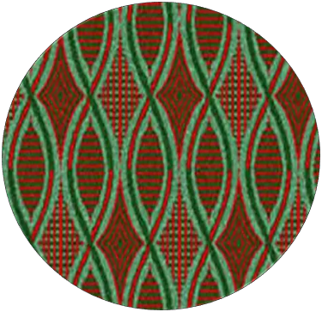
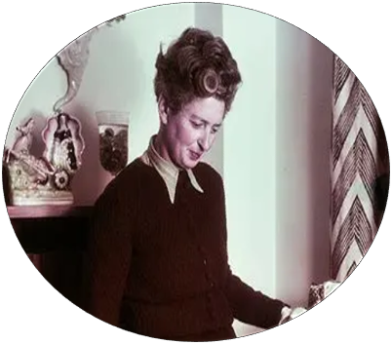
About Enid Marx
Enid Marx (1902–1998) was a British artist and designer celebrated for her imaginative textile patterns and bold use of shape, colour and repetition. She trained at the Central School of Arts and Crafts and the Royal College of Art but failed her final assessment and left before finishing her degree. Marx went on to work for textile designers then set up her own studio. She later became known for her modern approach to design; transforming simple marks and everyday forms into striking repeating motifs.
Marx is best known for her London Underground seat fabrics, or moquettes, created in the 1930s. These textiles combined lively geometric patterns with practical purpose; the busy, layered designs helped to disguise dirt and wear, making them ideal for public transport. Her work set a new standard for functional yet visually engaging design.
Alongside textiles, Marx produced woodblock prints, book covers, and postage stamps, always showing the same love of hand-crafted pattern. Her legacy continues to inspire designers today, demonstrating how even the simplest marks can become dynamic, decorative designs.
Find out even more:
Compton Verney Marx - Lambert Collection
London Transport Museum

Slide 5
Learning Objectives
To take part in a gallery experience, finding, comparing and sketching examples of pattern and design.
To learn about Enid Marx and her approach to pattern and design.
To understand how colour, textures, marks and shapes can be developed into repeating designs.
To experiment with mark making, pattern-building and repeated pattern.
To observe Enid Marx’s designs and find inspiration for their own print design.
To talk about their own work and the work of other artists.
Learning Outcomes
Understanding of the life and work of Enid Marx.
Ability to playfully create different marks and patterns using a variety of materials.
Contribute to a collaborative piece of artwork. (EYFS)
Create a piece of artwork inspired by the work of Enid Marx.
Developed fine motor and artistic skills through sketching and using a variety of materials.
Analyse and evaluate their own work and the work of others.

Slide 6
Itinerary
10:00 – 10:15 Welcome and introduction at the Learning centre.
10:15 – 11:00 Gallery visit: Look at examples of pattern, print and design across the exhibition. Pattern hunt activity, collect examples of patterns through sketching and rubbings.
11:00-12:00 EYFS/KS1 (optional) Create a Messy Mark Library on a large sheet of paper
KS1/2 Create a design for their poly tile.
12:00 – 12:30 Lunch in the park or Learning Centre (picnic blankets provided).
12:30 – 14:00 Carousel of activities
EYFS- Messy printing, paper pattern craft and marble printing
KS1-Choice of messy printing or poly tile printing and paper pattern craft
KS2-Poly tile printing with repeated patterns and advanced paper pattern craft with more complex designs
14:00 Walk back to Welcome Centre and board coach.

Slide 7
Top Tips
Planning your visit and making the most of the day
Your group will need appropriate clothing that they don’t mind getting messy
Prior to your visit, please make us aware of any students with additional requirements or special needs so we can make all necessary arrangements to support your students
We recommend staff bring a camera to record activities
We’re a cashless site, please contact us in advance if you would like the children to visit the shop
Students will need to bring a packed lunch and be supervised during lunch break.
We encourage all adults to lead by example, that includes getting stuck in and having a go at the activities too!
Teacher ratio for Primary School 1:6 and Secondary School 1:15
Children 12 years old and under must be accompanied by an adult at all times. The supervising adult must be over the age of 18
We cannot lead workshops or tours without a teacher present
On arrival, coaches can drop off in the carpark. Coaches cannot drop off at the gallery owing to weight restrictions on the Upper Bridge.
When arriving, please enter through the gate to the left of the Welcome Centre. The walk from the car park will take approximately 5-7 minutes. A member of the Learning Team will meet you outside the gallery.

