Slide 1
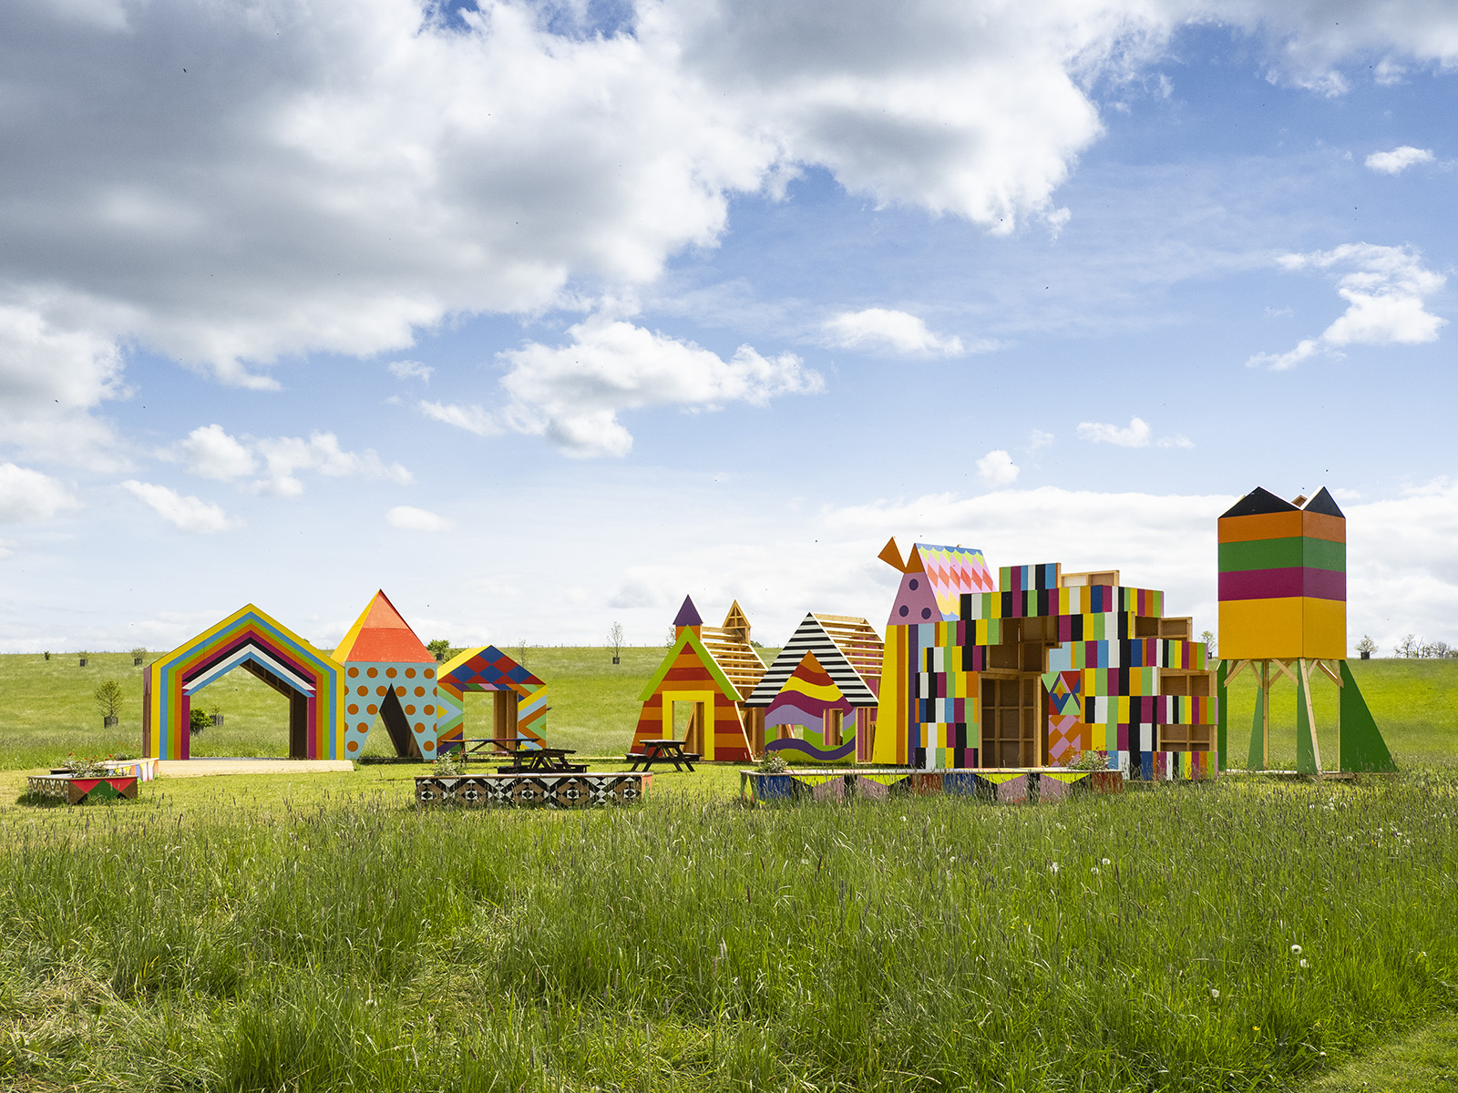

Appointment of
Data & Evaluation Coordinator
October 2024

Slide 2
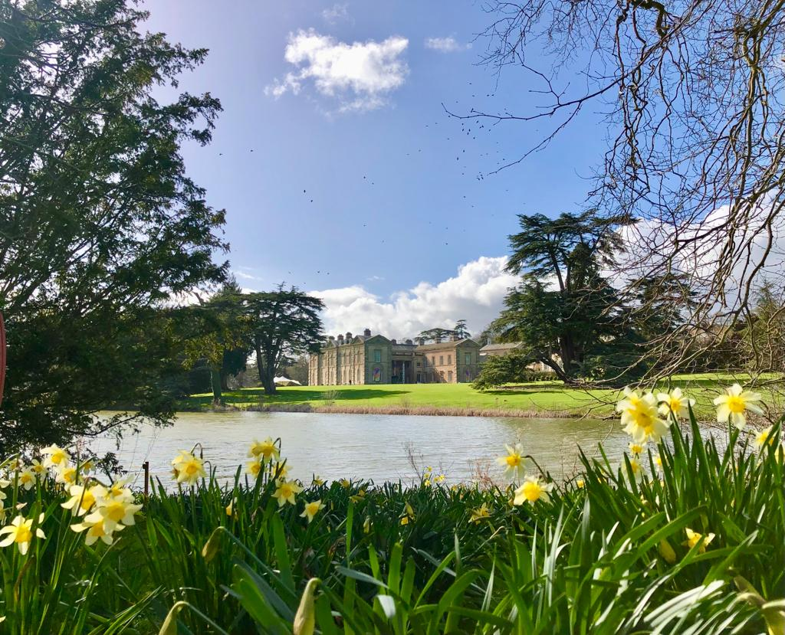

Slide 3
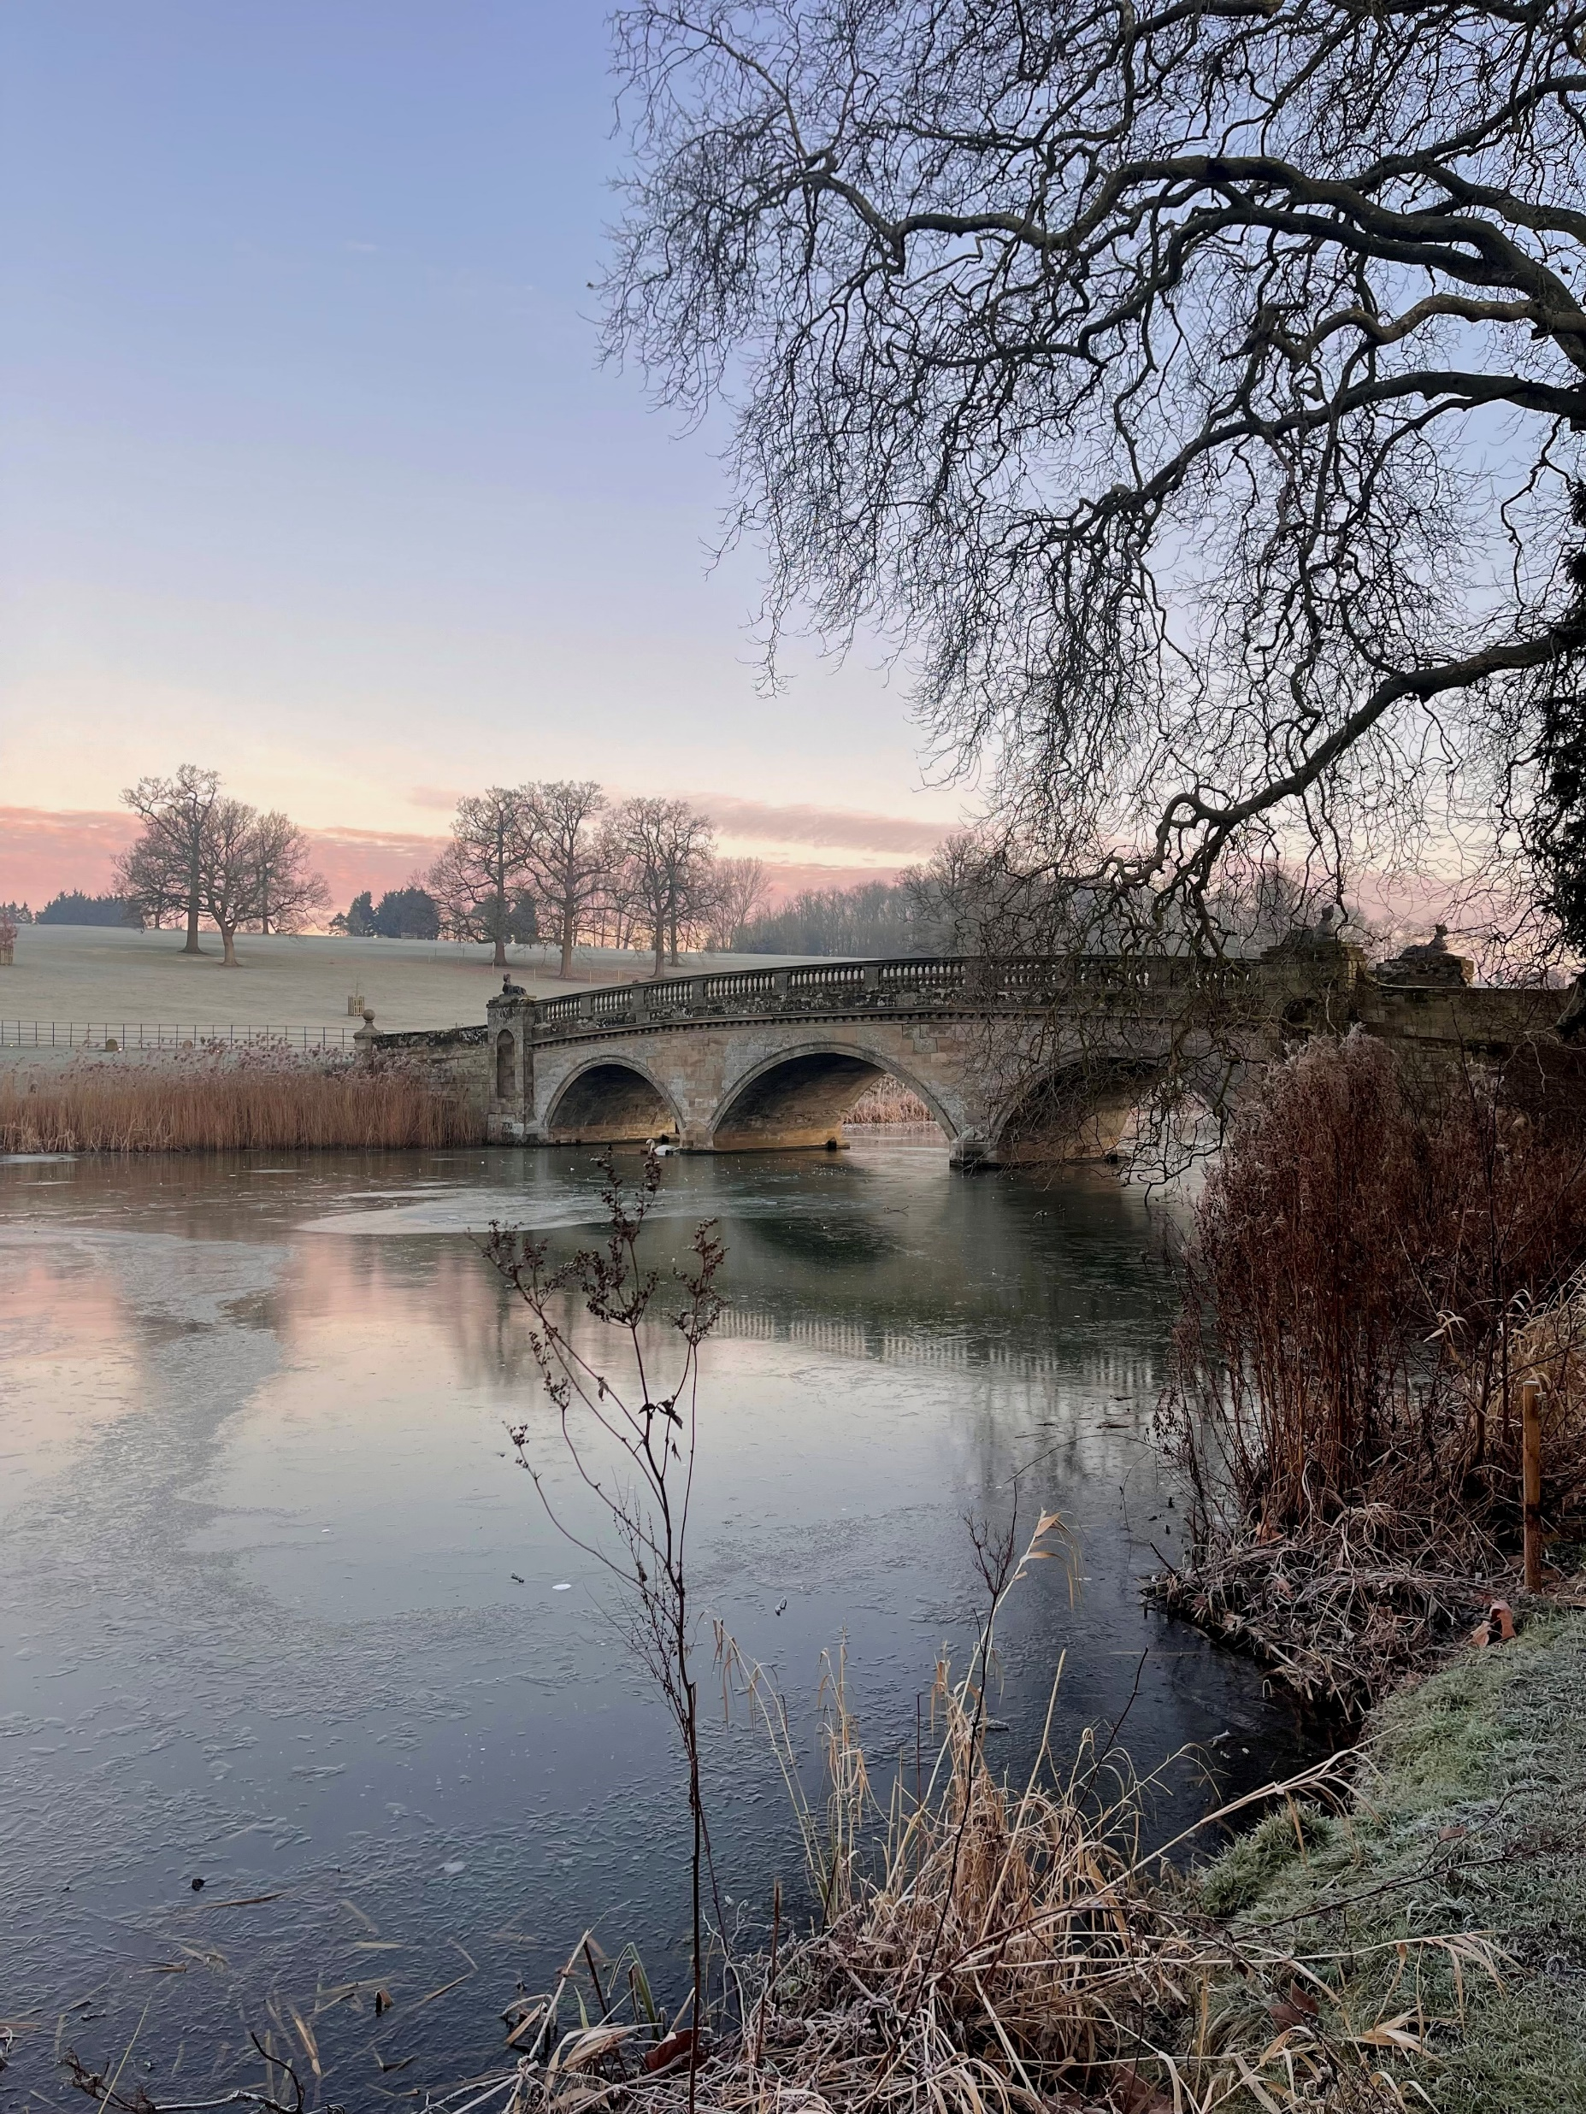
About Us
Compton Verney is an extraordinary place, that connects people with art, nature and creativity.
We are an award-winning gallery and visitor destination, with six permanent collections (Naples, Northern European Art 1450-1650, British Portraits, Chinese, British Folk Art and The Marx-Lambert Collection) and a schedule of thought-provoking changing exhibitions and events. We are an accredited museum, and a registered charity, based in a Grade I-listed Georgian mansion amidst 120 acres of Grade II- listed Lancelot 'Capability' Brown parkland in Warwickshire.
Compton Verney seeks to continue to increase visitor numbers, grow membership and improve the visitor experience. We have an extensive commercial offer part of which is excellent catering and retail, aiming to maximise income to the charity whilst also delivering the organisation’s purpose.
We will secure adequate resources to sustain the organisation in the long term, by building our profile locally, regionally, nationally and internationally, and by developing collaborative partnerships with other organisations.
COMPTONVERNEY.ORG.UK

Slide 4







Mission, Vision and Values
MISSION
We connect people with art, nature and creativity
VISION
To be a model place for regeneration through art.
VALUES
Collaborative
We are collaborative, working with artists, audiences, and communities; exploring the historic and the contemporary, the indoor and outdoor.
Sustainable
We harness opportunities to be environmentally sustainable and ae always responsible.
Bold
We are bold, purposeful, and confident and think, make and learn.
Inclusive
We are inclusive, creating a warm, welcoming and respectful culture.
Fun
We are fun and want everyone to have a great experience of Compton Verney.
COMPTONVERNEY.ORG.UK

Slide 5
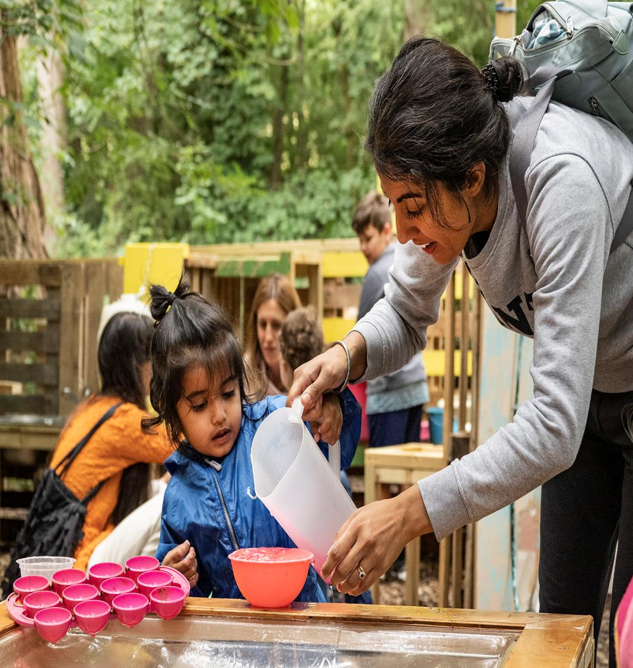
Charitable Objects
These are Compton Verney House Charity’s charitable objectives; they underpin all that we do and state why we exist and what we are setting out to achieve:
a) To promote wellbeing, physical and mental health through the provision of physical and digital access to and facilities for the appreciation, study and practice of the arts, culture, nature, heritage and science on the Compton Verney estate and/or any other place or places.
b) The advancement of education and learning in the United Kingdom and in particular in the West Midlands.
c) The commissioning and collecting of art, and the preservation and public display of a collection of art, for the benefit of the public.
d) The preservation, protection, improvement and sustainability of the Compton Verney estate’s historic buildings, landscape and natural environment in order to promote (a), (b) and (c)
COMPTONVERNEY.ORG.UK

Slide 6
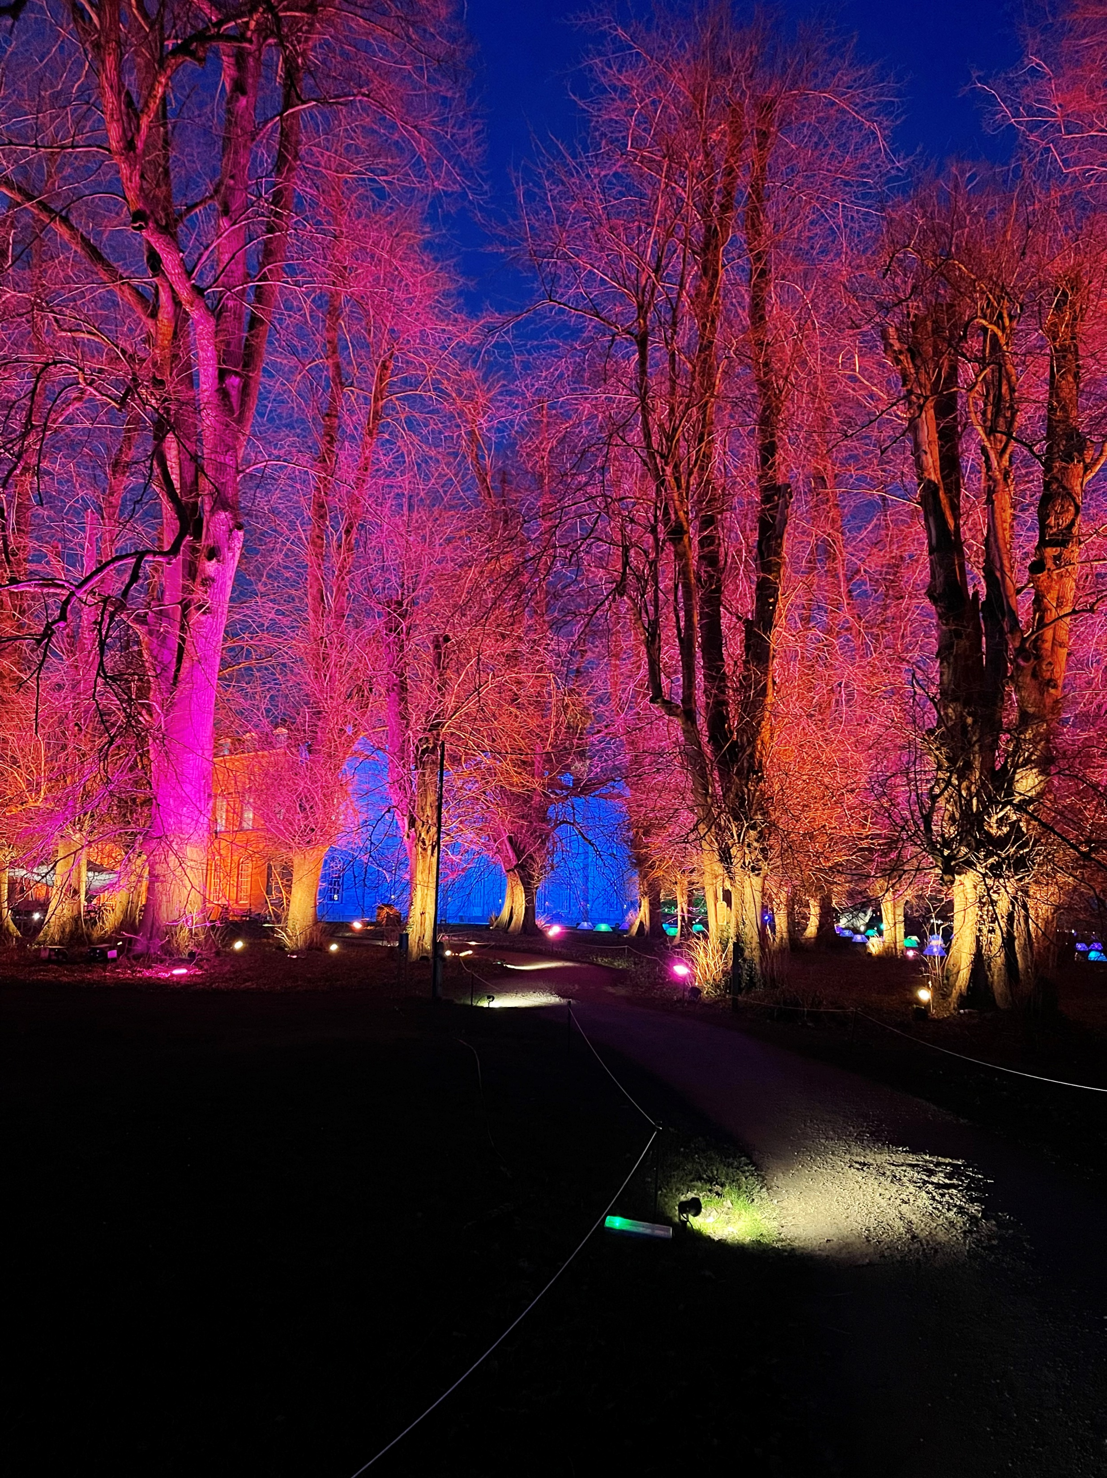
Equality, Diversity & Inclusion
Inspired by our founder Sir Peter Moores, we believe that great art is for everyone, and that culture should have no boundaries.
To ensure we meet our value of inclusion and to create a warm, welcoming and respective culture for all, we are committed to:
Delivering the short medium and long term goals in our action plan
Creating a culture of inclusion
Creating long term relationships with Black and underserved communities to work with as artists, advisors, programmers and curators
Gathering evidence, establishing our base line and surveying staff and volunteers so we track our progress
Working with sector experts to continue learn
Applying our commitment to inclusion in the recruitment of and ongoing working relationships with our staff, volunteers and trustees
COMPTONVERNEY.ORG.UK

Slide 7
The Role
This is a fantastic opportunity for a data-minded professional to join an exciting and newly structured Marketing and Admissions Team to help drive organisational change around audiences, data and evaluation.
The Data and Evaluation Coordinator will work with colleagues and volunteers to collate and evaluate a range of audience and impact data that will support strategic thinking across the organisation. Working with the Head of Marketing and Admissions and under the new position of Audience Insight Lead, you will play a key role in making a transformational change in how Compton Verney collects, evaluates and strategically uses data to drive its audience, programming and fundraising activity and support implementation of audience segmentation.
COMPTONVERNEY.ORG.UK

Slide 8
Key Responsibilities
Review and establish the data needs of Compton Verney in relation to evaluation, audience segmentation, marketing, impact reporting and fundraising.
Work with audience focused departments to collect, record, centrally collate and evaluate relevant data.
Where processes do not exist to achieve this, design, implement and imbed processes to record required data.
Evaluate data currently collected through visitor surveys and daily work of departments, identifying trends, gaps, successes and failures and presenting to Managers and Senior Leadership Team to drive strategic thinking and day-to-day operations.
Work closely with Development and Marketing Teams to provide vital reports and statistics evidencing
impact to strengthen fundraising messaging and proposals and marketing message, helping to leverage significant further funding through public and private support.
Support the Audience Insight Lead in creation of bespoke Compton Verney audience segmentation its integration with Compton Verney’s Spektrix CRM system in an easy-to-use way that can inform our audience and communication strategy and activity.
Being the ‘voice of the audience’, helping to shift the organisation to an audience first approach, consulting audiences about their needs, programming for specific audience segments and evaluating as part of a culture of learning and improvement.
COMPTONVERNEY.ORG.UK

Slide 9
Additional Responsibilities
Play a key role in the Marketing and Admissions Team to champion a data-driven culture and implement change
Deputise for the Audience Insight Lead where relevant
Be part of the planning group at Compton Verney, working collaboratively to support the data needs of the organization
The Postholder may be required to undertake other duties which may be reasonably requested and which are compatible with the overall scope and authority of the role.
Key Skills
Strong numerical skills.
Understanding and experience of data analysis.
Understanding of the application of research and data analysis and ability to report results to inform strategy.
Experience of using CRM systems, with a preference for Spektrix although not essential
Ability to project manage.
Ability to effectively operate within GDPR and PECR guidelines and share best practice.
Highly organised with keen attention to detail and an ability to prioritise workload, manage expectations and meet deadlines to budget.
Ability to support colleagues in data literacy.
Interpersonal skills, able to work collaboratively and with a multiple range of roles.
COMPTONVERNEY.ORG.UK

Slide 10
Team Structure Chart
Head of Marketing &
Admissions
Audience Insight Lead
Membership &
Admissions
Manager
Marketing &
Communications
Manager
Data & Evaluation Coordinator
Membership &
Admissions
Assistants
Senior Sales
Assistants &
Sales Assistants
Digital Marketing Coordinator
Marketing &
Communications
Coordinator
COMPTONVERNEY.ORG.UK

Slide 11
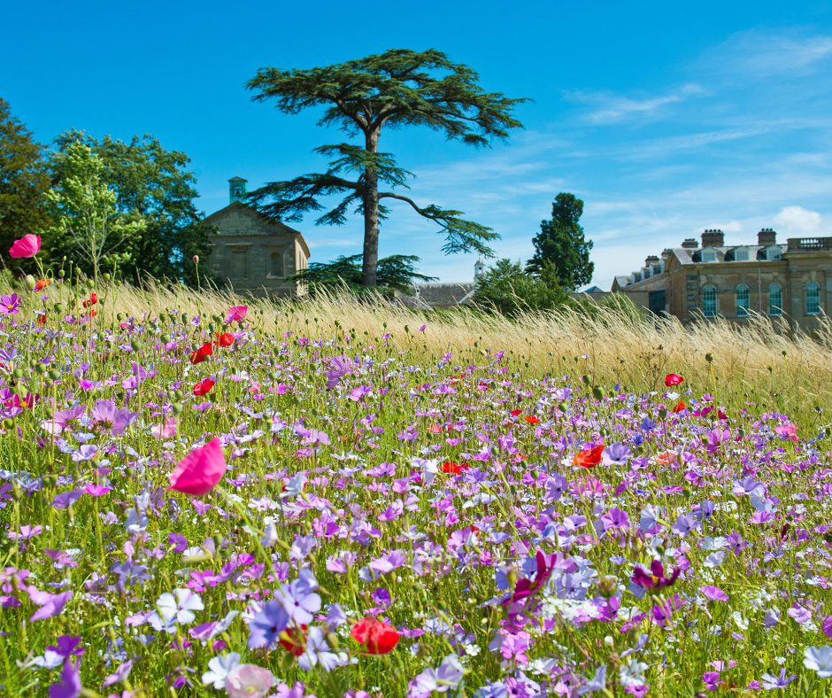
Additional Details
Location Compton Verney, CV35 9HZ
Salary £25,000 - £28,000
Reports to Audience Insight Lead
Term Permanent
Starting date January 2025
Hours 37.5 hours per week
Compton Verney Benefits
Pension scheme of up to 6% basic salary
Staff Membership and discount
Charity workers discounts i.e. gym memberships, shopping discount codes, insurance discounts
Holiday allowance up to 28 days relating to length of service
Flexible working whenever possible
Access to a wellbeing portal, App and Employee assistance programme (EAP)
Free parking
Eyecare Vouchers
Life Assurance
Signed up to More than a Moment Pledge
Training and development opportunities
COMPTONVERNEY.ORG.UK

Slide 12
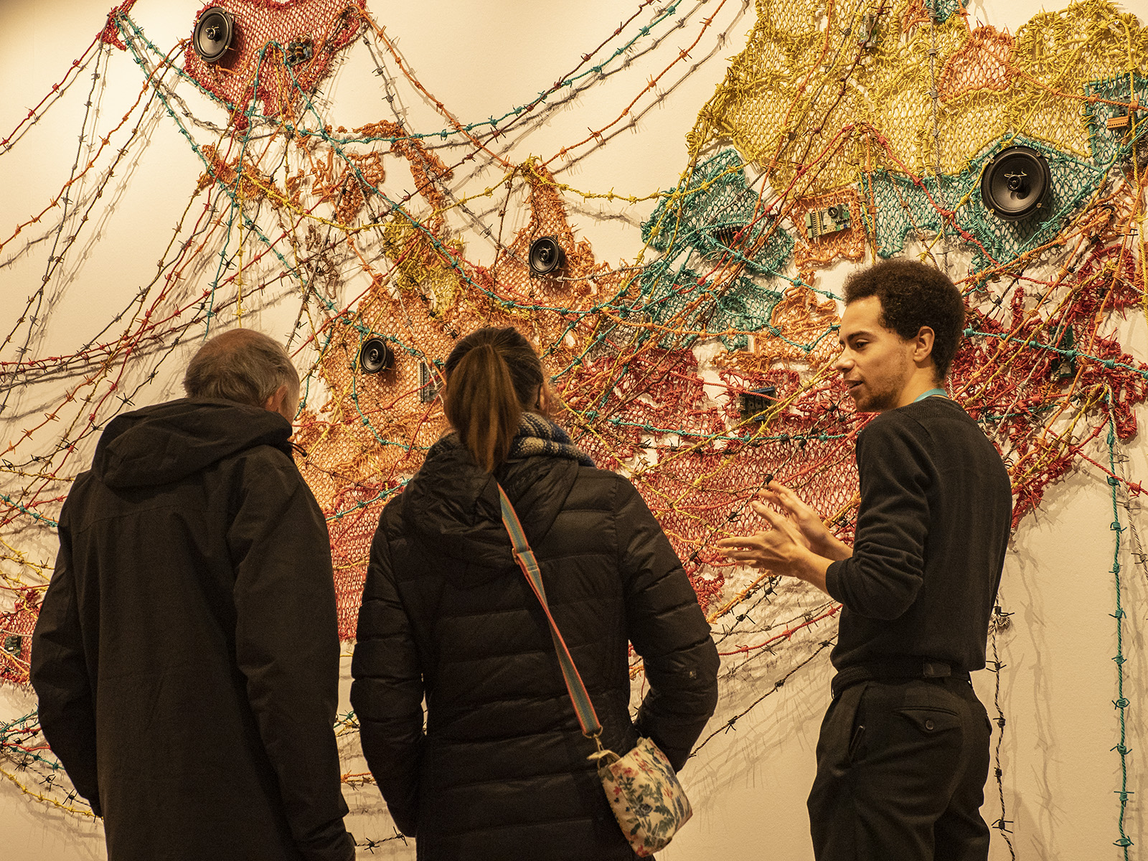
How to Apply
Please complete the attached application form along with your CV and a covering letter/video application expressing why you are suitable for the role, referencing the job description and person specification to us via:
https://recruitment.evalu-8.com/public/recruitment_post?id=NzdaM3JXSE1iWlBDTUUxVnNaZUJSUT09&org_id=T0VZYUsyNDhaak41cnM4UjYxa3prdz09
If you have any questions or need any additional support with your application, please contact comptonverneyhr@comptonverney.org.uk
Timeline
Position Advertised: Monday 28th October 2024
Applications Close: Thursday 21st November 2024
Interviews: First interview: 29th November 2024
COMPTONVERNEY.ORG.UK

