Slide 1
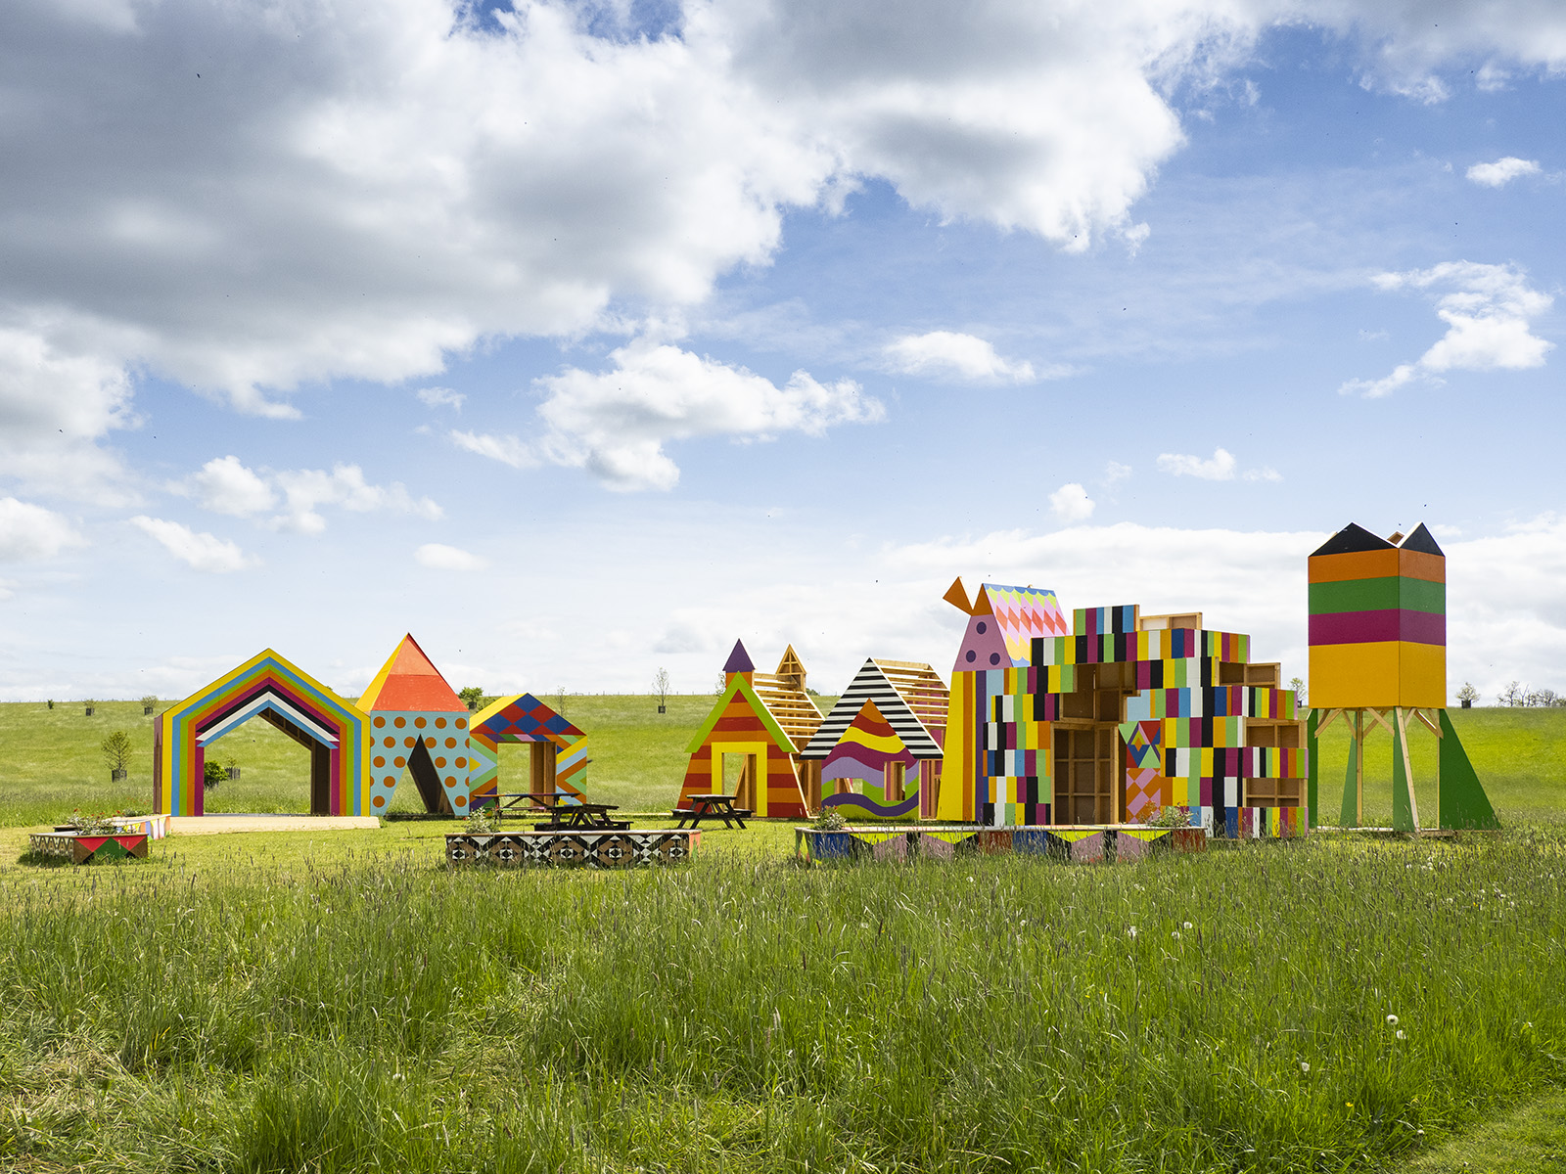
Appointment of Audience Insight Lead
October 2024

Slide 2
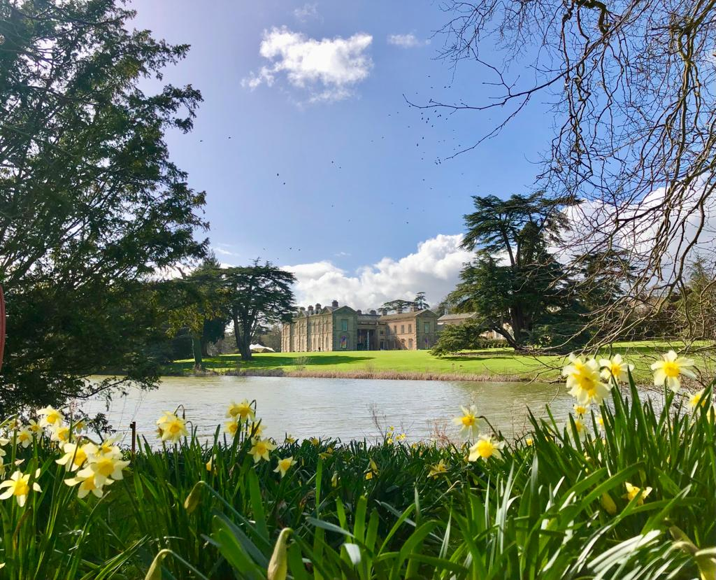

Slide 3
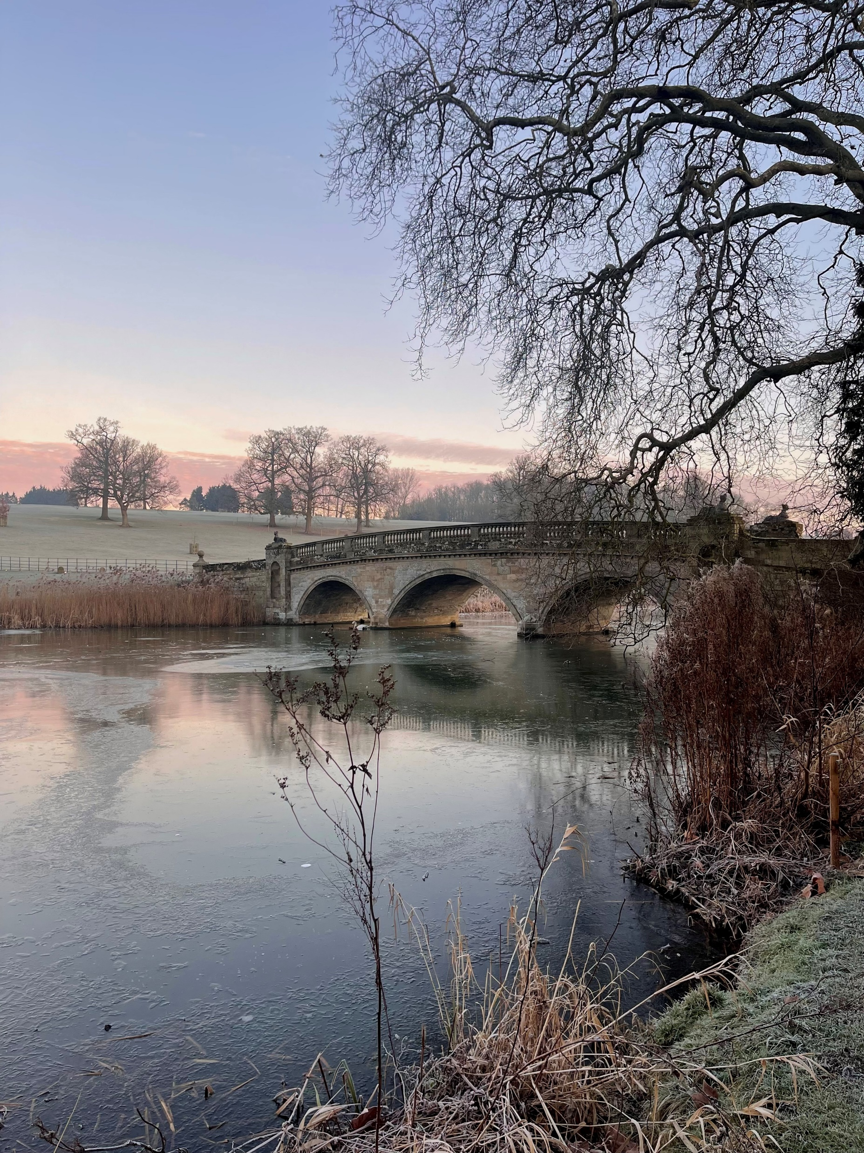
About Us
Compton Verney is an extraordinary place, that connects people with art, nature and creativity.
We are an award-winning gallery and visitor destination, with six permanent collections (Naples, Northern European Art 1450-1650, British Portraits, Chinese, British Folk Art and The Marx-Lambert Collection) and a schedule of thought-provoking changing exhibitions and events. We are an accredited museum, and a registered charity, based in a Grade I-listed Georgian mansion amidst 120 acres of Grade II- listed Lancelot 'Capability' Brown parkland in Warwickshire.
Compton Verney seeks to continue to increase visitor numbers, grow membership and improve the visitor experience. We have an extensive commercial offer part of which is excellent catering and retail, aiming to maximise income to the charity whilst also delivering the organisation’s purpose.
We will secure adequate resources to sustain the organisation in the long term, by building our profile locally, regionally, nationally and internationally, and by developing collaborative partnerships with other organisations.
COMPTONVERNEY.ORG.UK

Slide 4
Mission, Vision and Values
MISSION
We connect people with art, nature and creativity
VISION
To be a model place for regeneration through art.
VALUES
Collaborative We are collaborative, working with artists, audiences, and communities; exploring the historic and the contemporary, the indoor and outdoor.
Sustainable We harness opportunities to be environmentally sustainable and ae always responsible.
Bold We are bold, purposeful, and confident and think, make and learn.
Inclusive We are inclusive, creating a warm, welcoming and respectful culture.
Fun We are fun and want everyone to have a great experience of Compton Verney.
COMPTONVERNEY.ORG.UK

Slide 5
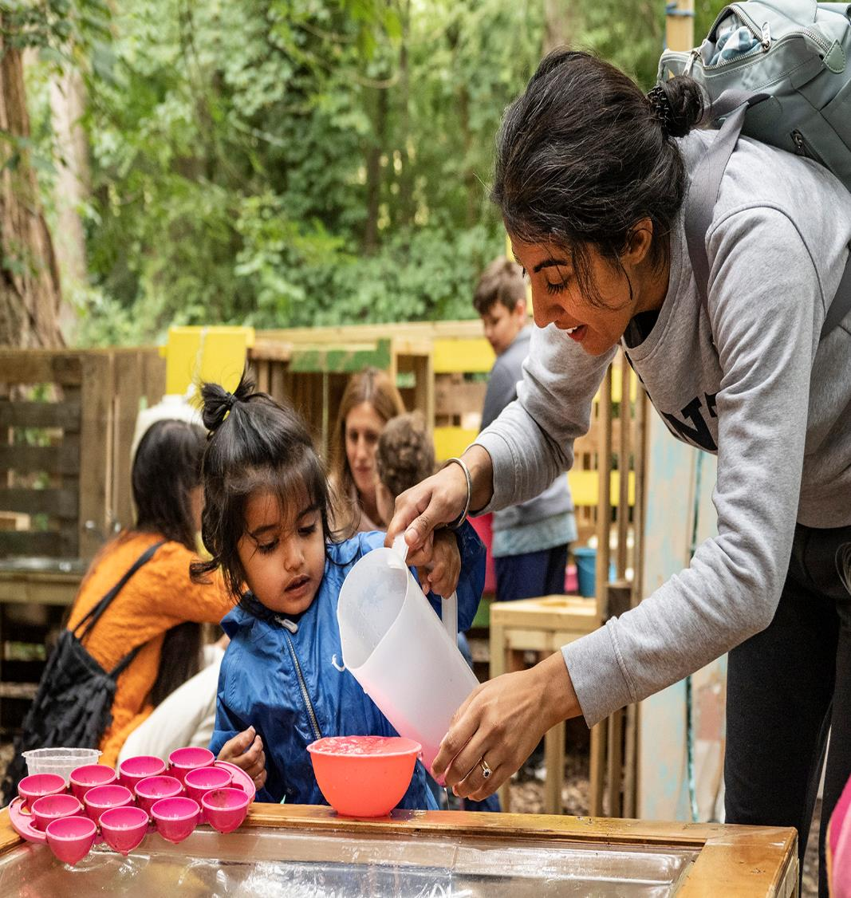
Charitable Objects
These are Compton Verney House Charity’s charitable objectives; they underpin all that we do and state why we exist and what we are setting out to achieve:
a) To promote wellbeing, physical and mental health through the provision of physical and digital access to and facilities for the appreciation, study and practice of the arts, culture, nature, heritage and science on the Compton Verney estate and/or any other place or places.
b) The advancement of education and learning in the United Kingdom and in particular in the West Midlands.
c) The commissioning and collecting of art, and the preservation and public display of a collection of art, for the benefit of the public.
d) The preservation, protection, improvement and sustainability of the Compton Verney estate’s historic buildings, landscape and natural environment in order to promote (a), (b) and (c)
COMPTONVERNEY.ORG.UK

Slide 6
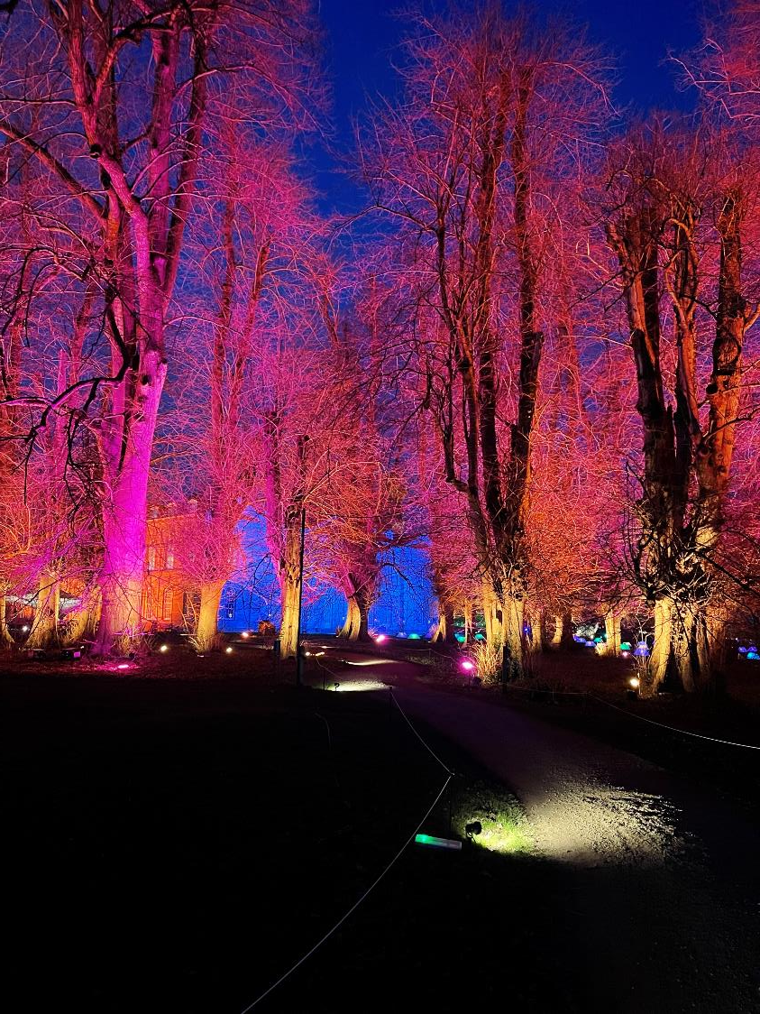
Equality, Diversity & Inclusion
Inspired by our founder Sir Peter Moores, we believe that great art is for everyone, and that culture should have no boundaries.
To ensure we meet our value of inclusion and to create a warm, welcoming and respective culture for all, we are committed to:
Delivering the short medium and long term goals in our action plan
Creating a culture of inclusion
Creating long term relationships with Black and underserved communities to work with as artists, advisors, programmers and curators
Gathering evidence, establishing our base line and surveying staff and volunteers so we track our progress
Working with sector experts to continue learn
Applying our commitment to inclusion in the recruitment of and ongoing working relationships with our staff, volunteers and trustees
COMPTONVERNEY.ORG.UK

Slide 7
The Role
This is a fantastic opportunity for an experienced audience insight professional to join an exciting and newly structured Marketing and Admissions team to help drive organisational change around audiences.
The Audience Insight Lead will be responsible for project managing the implementation of audience segmentation and working with Marketing and Admissions colleagues to make transformational change in how Compton Verney strategically uses data to reach and engage wider audiences and market to them more effectively. The Audience Insight Lead will also manage the new position of Data and Evaluation Coordinator.
COMPTONVERNEY.ORG.UK

Slide 8
Key Responsibilities
Segmentation and CRM
Project Manage the creation of bespoke Compton Verney audience segmentation, building on the work that has been previously undertaken by internal team and external consultants to finalise a model that would be most suitable and effective for Compton Verney.
Drive the process of integrating this information with Compton Verney’s Spektrix CRM system in an easy-to-use way that can inform our audience and communication strategy and activity.
Audience Insight
Work with Head of Marketing and Admissions and other colleagues to create bespoke communications to different audience segments based on their interests and motivations to drive increased footfall.
Work with Head of Marketing and Admissions to build greater regional awareness of Compton Verney and identify, strategically target and segment regional audiences who currently do not visit or engage with Compton Verney to support our visitor growth strategy.
Data Management, Reporting and Culture
Managing the amending and implementation of processes, systems and staff and volunteer training to collect the data required, on the scale required to enable comprehensive audience segmentation.
Being the ‘voice of the audience’, shifting the organisation to an audience first approach, consulting audiences about their needs, programming for specific audience segments and evaluating as part of a culture of learning and improvement.
COMPTONVERNEY.ORG.UK

Slide 9
Line Management
Manage the newly created role of Data and Evaluation Coordinator, supporting them to collect, record and evaluate data from across the organisation, helping to drive change towards being an audiences and data-led organisation.
Additional Responsibilities
Play a leading role in the Marketing and Admissions Team to champion a data-driven culture and implement change.
Deputise for the Head of Marketing and Admissions where relevant.
The Postholder may be required to undertake other duties which may be reasonably requested and which are compatible with the overall scope and authority of the role.
Key Skills
Experience of implementing and using segmentation, integrated with CRM system to improve marketing campaign reach or performance.
Experience in creating organisational insight, through data reporting and evaluation to support and guide strategy.
In-depth understanding of the application of research and data analysis and ability to report results to inform strategy.
Experience of using CRM systems, with a preference for Spektrix, although not essential.
Ability to project manage.
Ability to effectively operate within GDPR and PECR guidelines and share best practice.
Highly organised with keen attention to detail and an ability to prioritise workload, manage expectations and meet deadlines to budget.
Ability to train colleagues in data literacy.
Interpersonal skills, able to work collaboratively and with a multiple range of roles.
Line Management experience preferable but not essential.
COMPTONVERNEY.ORG.UK

Slide 10
Team Structure Chart
Head of Marketing & Admissions
Audience Insight Lead
Membership & Admissions Manager
Marketing & Communications Manager
Data & Evaluation Coordinator
Membership & Admissions Assistants
Senior Sales Assistants &
Sales Assistants
Digital Marketing Coordinator
Marketing & Communications Coordinator
COMPTONVERNEY.ORG.UK

Slide 11
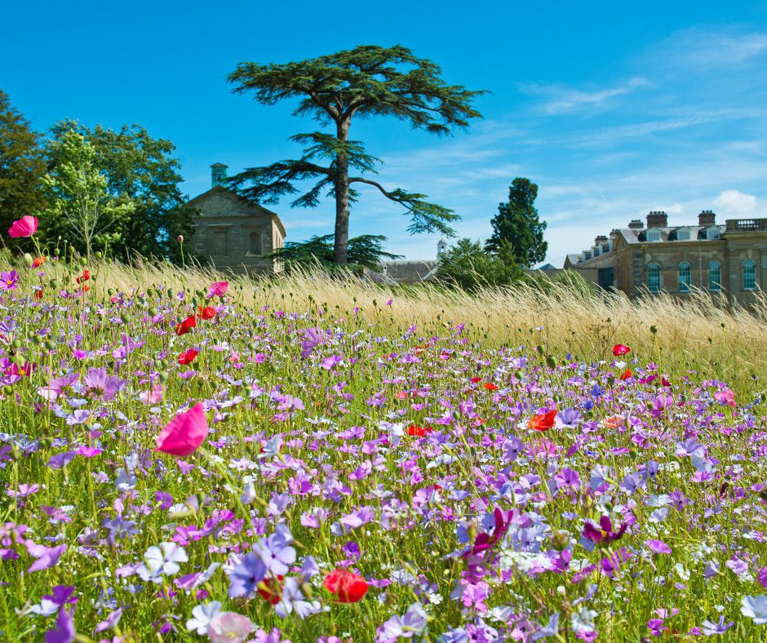
Additional Details
Location Compton Verney, CV35 9HZ
Salary £35,000
Reports to Head of Marketing and Admissions
Term Fixed-term, 3 years
Starting date January 2025
Hours 37.5 hours per week
Compton Verney Benefits
Pension scheme of up to 6% basic salary
Staff Membership and discount
Charity workers discounts i.e. gym memberships, shopping discount codes, insurance discounts
Holiday allowance up to 28 days relating to length of service
Flexible working whenever possible
Access to a wellbeing portal, App and Employee assistance programme (EAP)
Free parking
Eyecare Vouchers
Life Assurance
Signed up to More than a Moment Pledge
Training and development opportunities
COMPTONVERNEY.ORG.UK

Slide 12
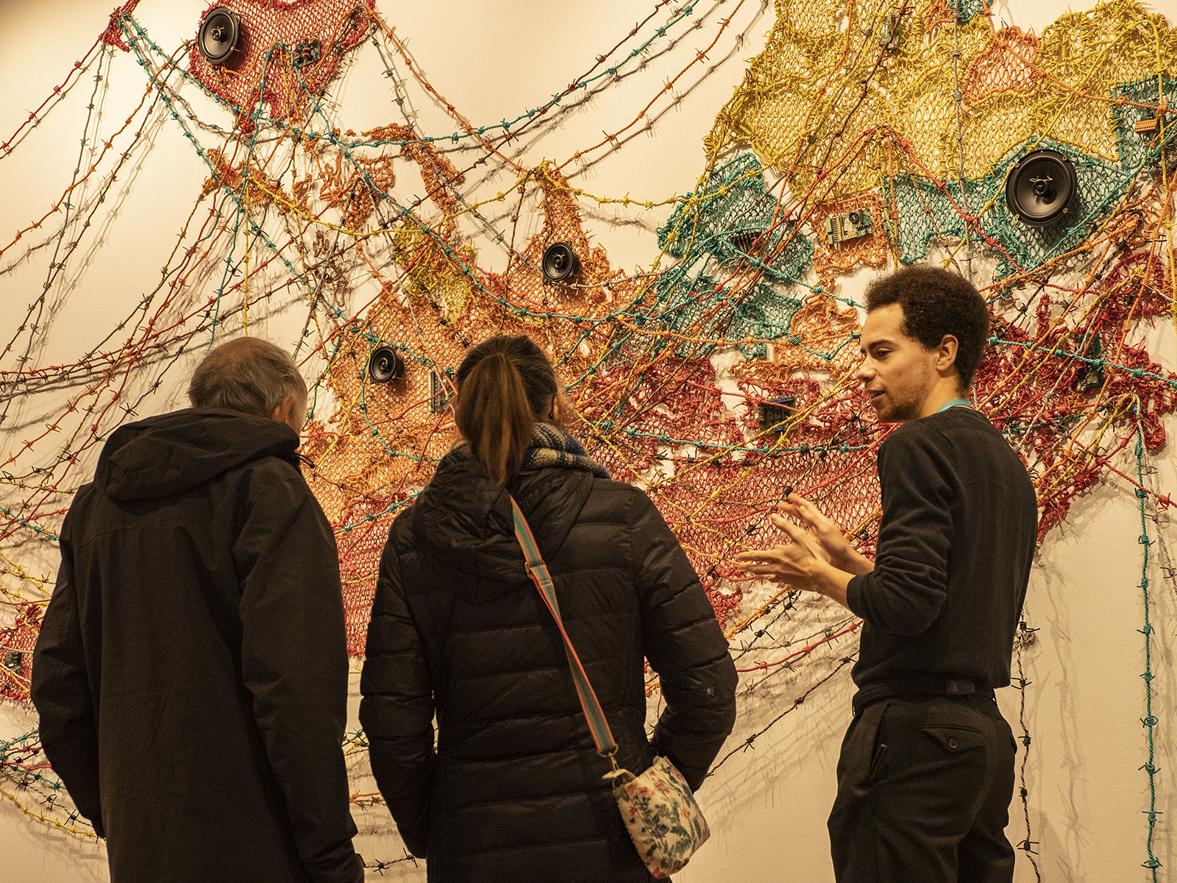
How to Apply
Please complete the attached application form along with your CV and a covering letter/video application expressing why you are suitable for the role, referencing the job description and person specification to us via:
https://recruitment.evalu-8.com/public/recruitment_post?id=MTloK0xrTkZPWUh5cy9PSkowQmYrdz09&org_id=T0VZYUsyNDhaak41cnM4UjYxa3prdz09
If you have any questions or need any additional support with your application, please contact comptonverneyhr@comptonverney.org.uk
Timeline
Position Advertised: Monday 28th October 2024
Applications Close: Sunday 17th November 2024
Interviews: First interview: Week of 25th November 2024
COMPTONVERNEY.ORG.UK

