Slide 1






Art & DESIGN
Welcome to the Art Gallery
TEACHERS PACK
KEY STAGE 2
C OMPT ONVERNE Y. ORG. UK

Slide 2
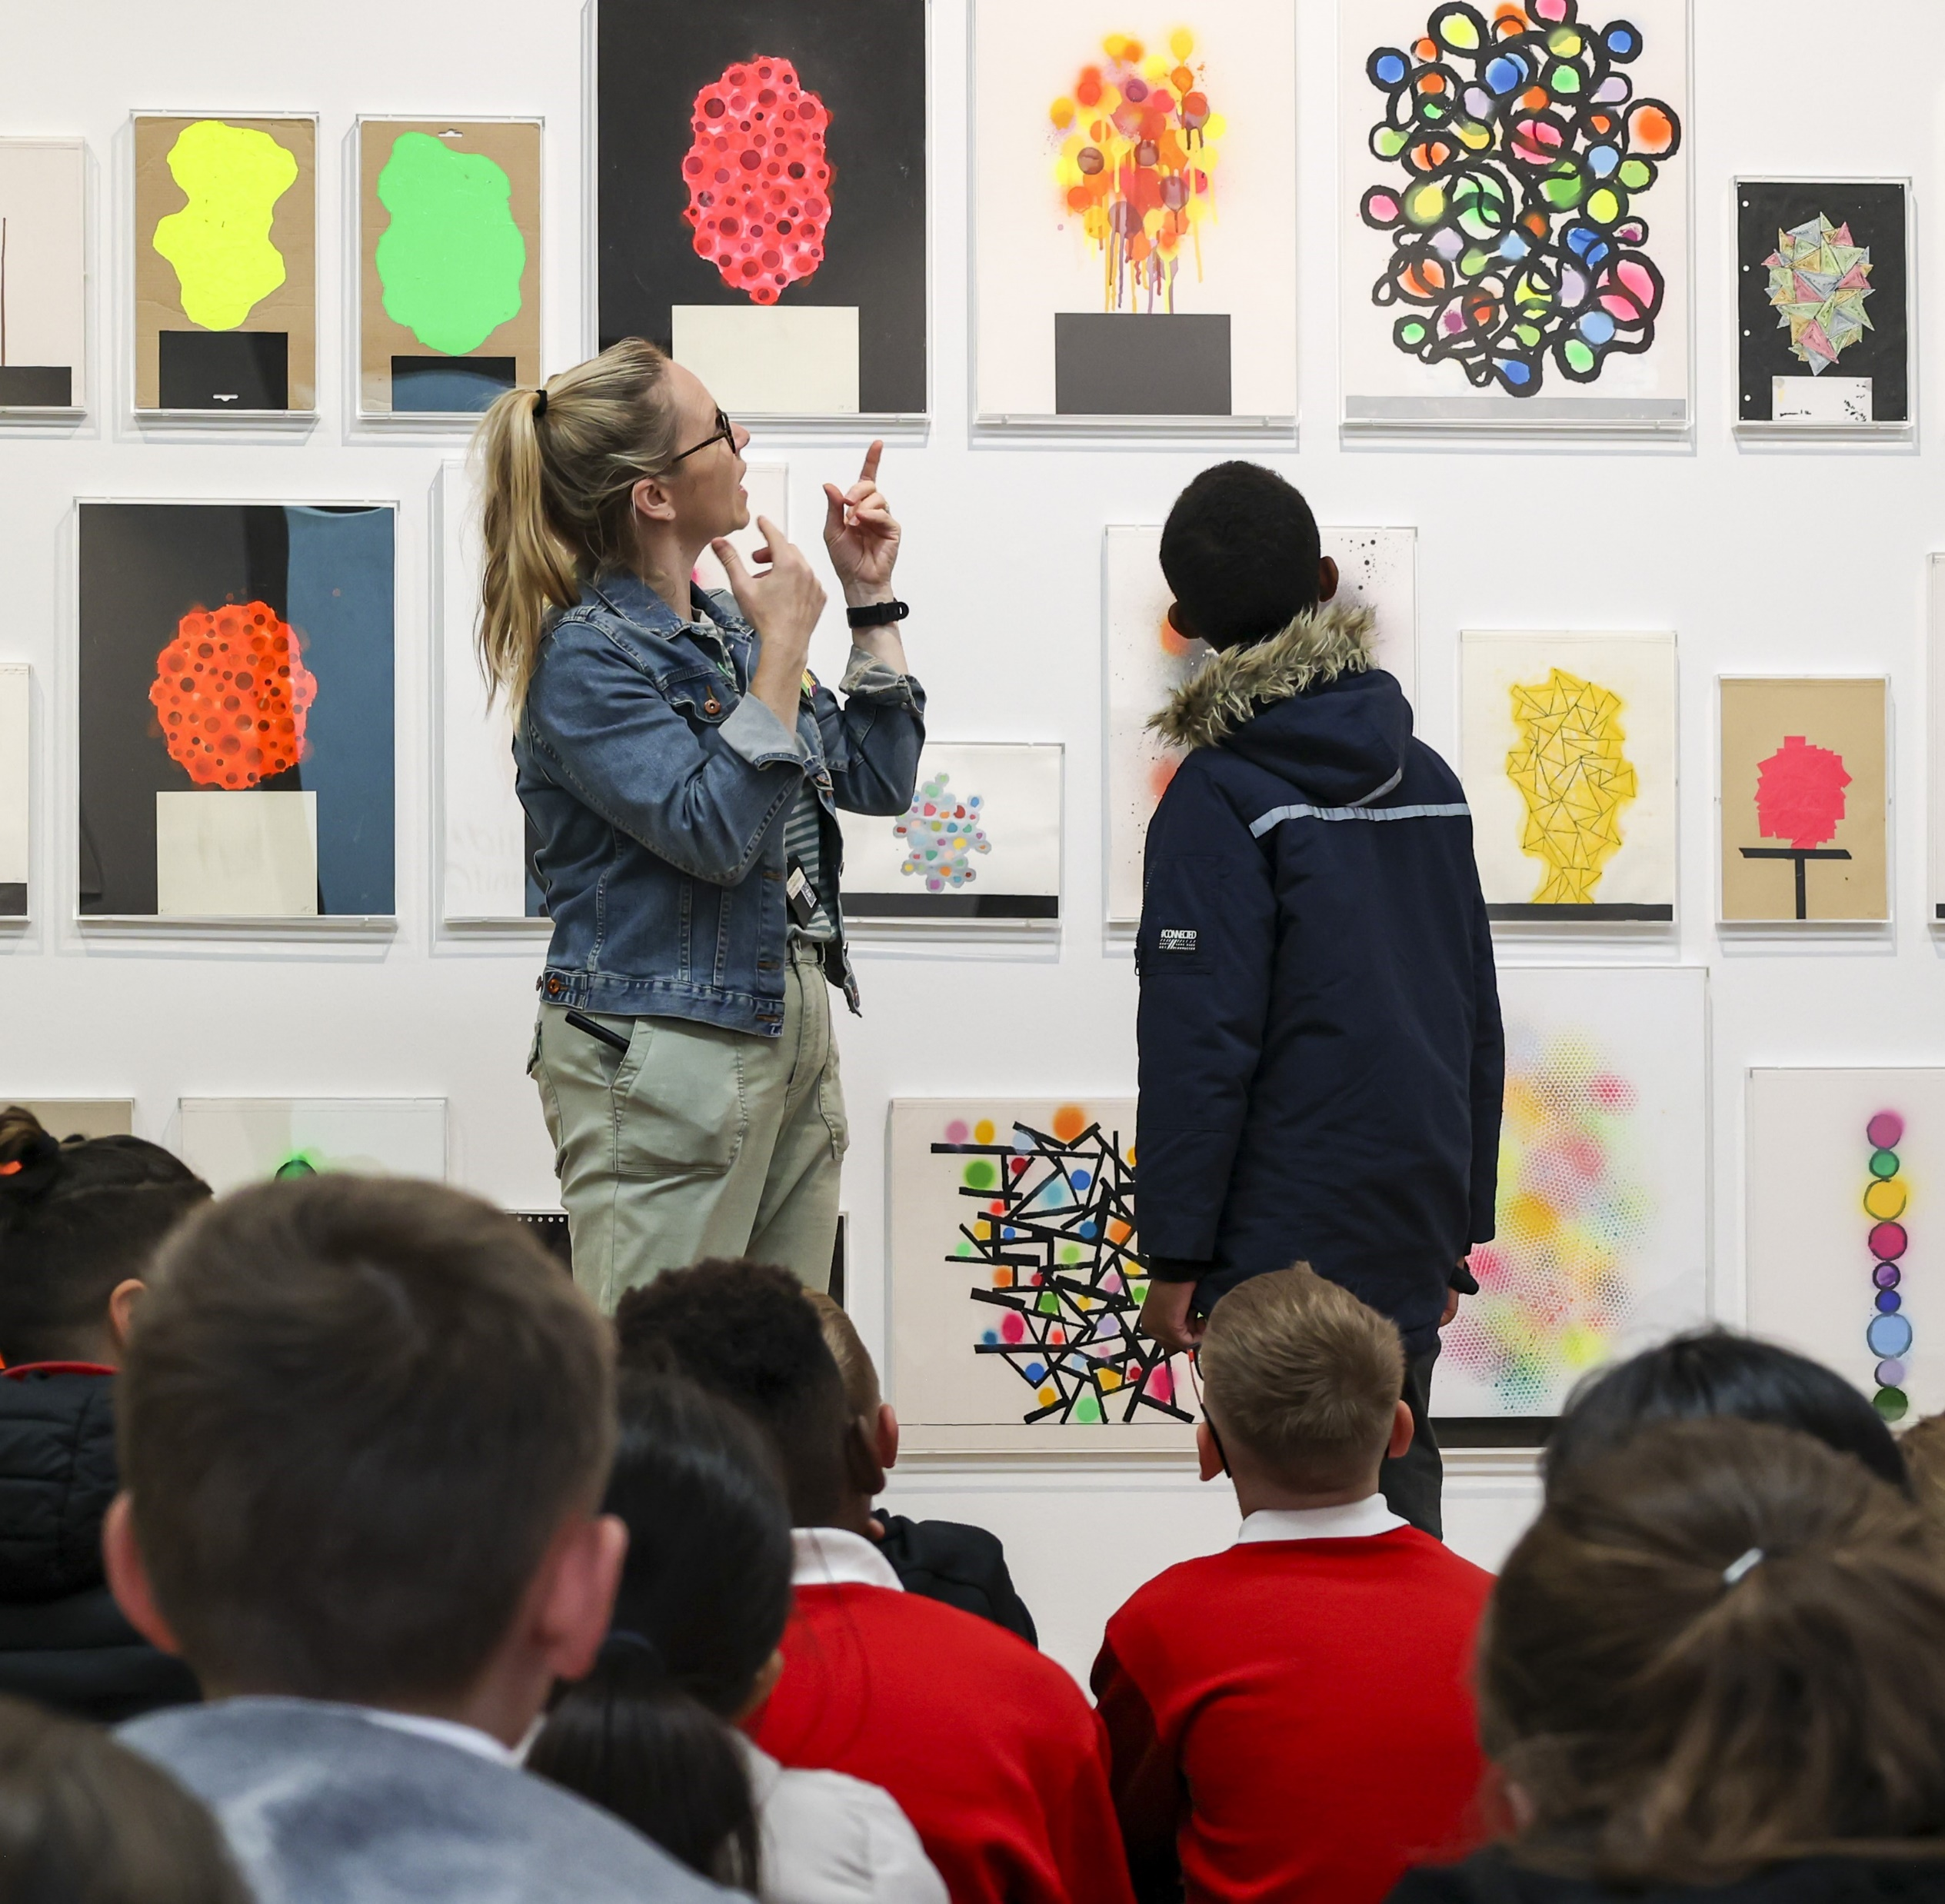
Contents
About the workshop
Itinerary
About Sculpture in the Park
About Folk Art
About up & coming Exhibitions
About Volcano Landscapes
Learning Objectives
Learning Outcomes
Top Tips for your visit
To book contact
Learning@comptonverney.org.uk
01926 645 563

Slide 3
About the workshop
Welcome to the Art gallery, this whopper of a day will introduce you to the world of artists and makers at Compton Verney. These multiple workshops involve lots of open-ended resources for making and chances to talk, developing ideas and opinions. We invite discussions: Who can make art? Can I be an artist? What is an Art Gallery? What are artists? Why do they make artwork? What have they made? and more.
Led by our Learning Team, you’ll explore the galleries and investigate different artists and their artworks. You’ll participate in 3 different workshops, each of which is 50 mins in duration and explores different themes. You’ll invent your own artworks in response and be encouraged to shape and develop your ideas using a range of creative media. You’ll experiment with sculpture, printing, drawing and more and develop different techniques for using colour, pattern, form, texture and shape. This is a full day with a variety of experiences and plenty of multi-sensory options to inspire imaginations and creativity.
For more information about each workshop option, please continue.
There are four workshops to choose from but please note that the temporary exhibition workshops will vary depending on the timing of your booking and the changing exhibition schedule. If your booking falls in between exhibitions, we will deliver the 3 available options. We are unable to deliver all 4 options at once. Please pick your 3 preferred workshops.
This day is ideal for large groups such as 2-3 classes. 4 classes will need to book over 2 days.
Maximum 35 children per workshop.
£9 per child, supporting adults are free. Minimum charge £180

Slide 4
Itinerary
ART AND DESIGN: WELCOME TO THE ART GALLERY
TEACHERS PACK EYFS & KS1
Timings | Class 1 | Class 2 | Class 3
09:50 | Arrive in coach park, walk up to the galleries
10:00 – 10:30 | Welcome, housekeeping, toilets; drop coats and bags; Walk to first workshop
10:30 – 11:20 | Workshop: EXHIBITION | Workshop: Pattern, Print, Play | Workshop: SCULPTURE IN THE PARK
11:20 – 12:10 | Workshop: SCULPTURE IN THE PARK | Workshop: Exhibition | Workshop: PATTERN,PRINT,PLAY
12:10 – 13:00 | Walk to Picnic area Lunch outside (or Learning rooms if wet) Toilets | Walk to Picnic area Lunch outside (or Learning rooms if wet) Toilets | Walk to Picnic area Lunch outside (or Learning rooms if wet) Toilets
13:00-13:50 | Workshop: PATTERN,PRINT,PLAY | Workshop: Sculpture in the Park | Workshop: EXHIBITION
13:50 | Workshops finish | Workshops finish | Workshops finish
13:50 - 14:15 | Goodbyes, collect bags and walk to the coach | Goodbyes, collect bags and walk to the coach | Goodbyes, collect bags and walk to the coach

Slide 5






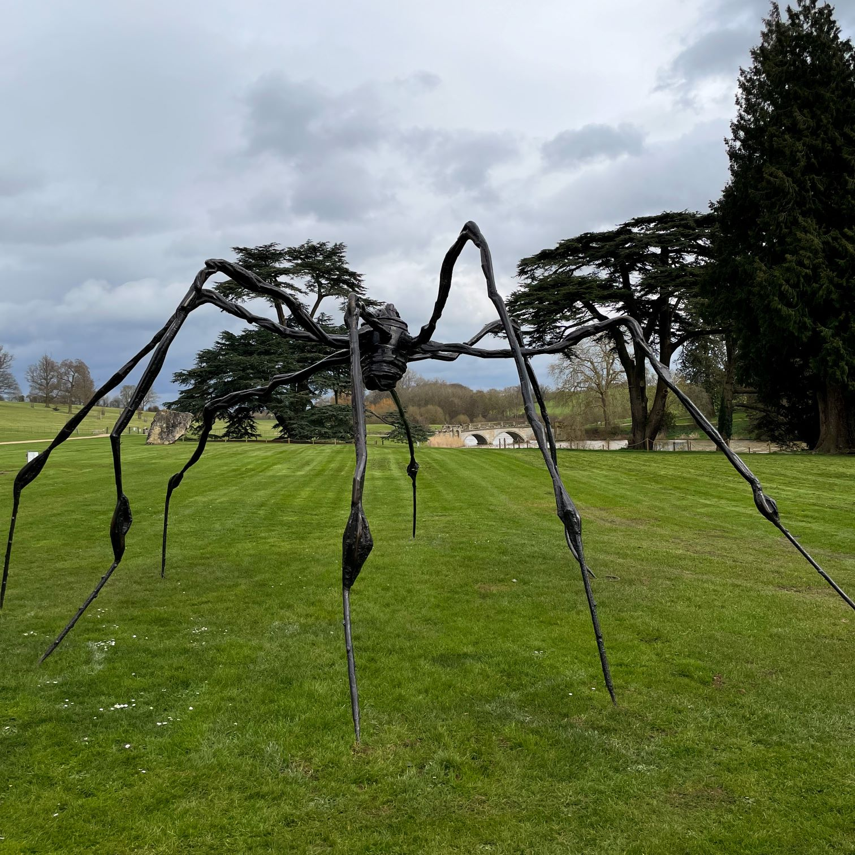
About Sculpture in the Park
ART AND DESIGN: WELCOME TO THE ART GALLERY
TEACHERS PACK KS2
The students will visit Compton Verney’s Sculpture in the Park with a member of the Learning Team. They will look at and discuss the sculptures. They will be encouraged to respond to what they see both verbally and physically. The trail will be playful, active and fun!
Inspired by the sculptures, the students will have the opportunity to create an individual piece which they can take away with them
Please note this workshop Welcome to the Art the Gallery highlights and explores sculptures by Louise Bourgeois, and Nicolas Deshayes. We’re not able to see all of the sculptures in the park during this workshop duration.
C OMPT ONVERNE Y. ORG. UK

Slide 6
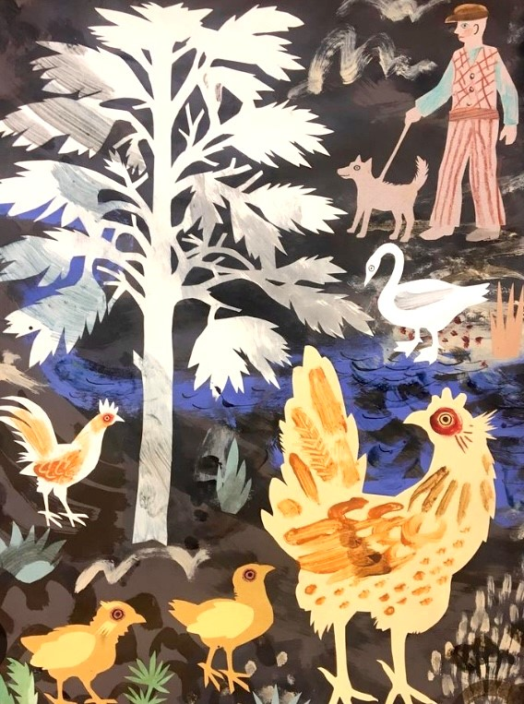
About FOLK ART
ART & DESIGN: WELCOME TO THE ART GALLERY
TEACHERS PACK KS2
Folk Art refers to objects and artworks made by everyday people who didn’t go to art school. Students will explore the objects and artworks on display, their stories and social history. The gallery showcases giant shop signs, children’s toys, a huge tapestry and many more items. Folk Art is quirky, fun and accessible. It highlights the importance of creating for function, tradition and wellbeing.
Students will learn about contemporary artist Mark Hearld who created a variety of art works in response to Compton Verney’s Folk Art collection. Students will see examples of how his works spans a range of Art and Design media such as sculpture, wallpaper print and paper collage.
Inspired by the Folk Art objects, and Mark Hearld, students will design and create their own collage. Students are encouraged to consider composition, pattern, texture and develop a narrative for their collages. The students can take their collages back to school to include in their sketch books.
C OMPT ONVERNE Y. ORG. UK

Slide 7
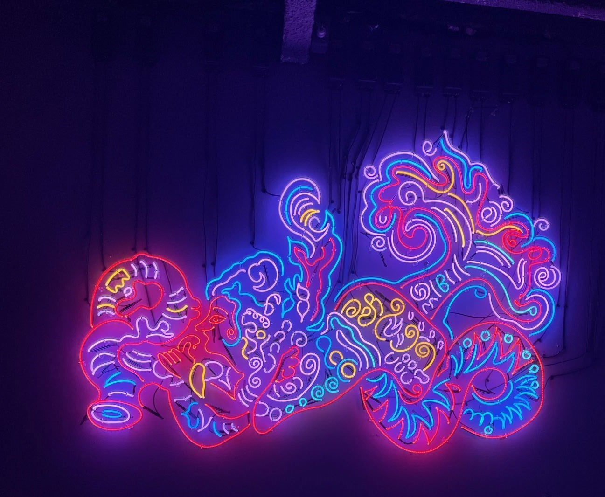
About up & Coming Exhibitions
ART & DESIGN: WELCOME TO THE ART GALLERY
TEACHERS PACK KS2
Louise Bourgeois Artist Rooms
6th July – 6th October 2024
Workshop highlights and themes include: storytelling, memories, textiles, spider sculptures, shapes and drawings. You’ll experiment with different drawing materials and create a large collaborative piece.
Chila Kumari Singh Burman
26th October 2024 – 26th January 2025
Workshop highlights and themes include: identity, memories, colour, print, portraits and neon lights. You’ll experiment with creating glow in the dark artworks.
C OMPT ONVERNE Y. ORG. UK

Slide 8
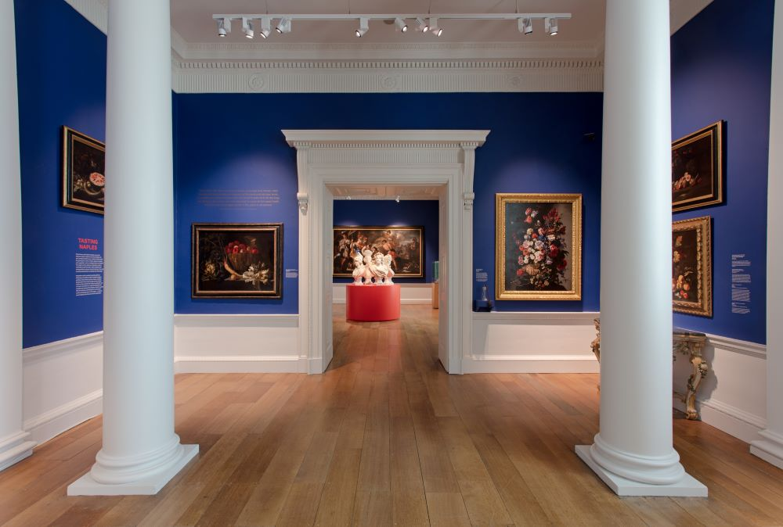
About Volcano Landscapes
ART & DESIGN: WELCOME TO THE ART GALLERY
TEACHERS PACK KS2
Can you see the orange glow of lava? What does an erupting volcano smell like? What can you hear?
Sensing Naples is a multi-sensory gallery space, curated to encourage curiosity and imagination through the different senses: sight, sound, smell and touch. It tells the history and traditions of Neapolitan art.
The students will be introduced to a painting of volcano Vesuvius erupting at night, they will share what they can see and the story that’s unfolding. They will discuss composition, contrast, complementary colours and the techniques the artist has used to create mood and drama in a painting. They will create a soundscape in response, as if the painting has come alive!
The students will explore the Sensing Naples gallery for inspiration and then in small groups create their own volcano landscape and story using a range of materials and loose parts, such as fabrics, blocks, papers, sticks and more. Bring a camera to take photographs as the materials will be repurposed.
C OMPT ONVERNE Y. ORG. UK

Slide 9
Learning Objectives
ART & DESIGN: WELCOME TO THE ART GALLERY
TEACHERS PACK KS2
To visit an art gallery and see a variety of art works,
To learn about artists, designers and craft makers, referencing the historical and cultural development of their art forms.
To describe the differences and similarities between art works
To explore and gain knowledge of different types of art, craft and design
To safely use and explore a variety of materials, experimenting with design, texture, colour, form and shape.
To create works of art, independently and collaboratively
Invent, adapt and recount narratives and stories with peers and their teacher
To develop artistic skills and creative thinking
To evaluate and analyse creative works using the language of art, craft and design
To encourage positive social skills through team building activities

Slide 10
Learning Outcomes
ART & DESIGN: WELCOME TO THE ART GALLERY
TEACHERS PACK KS2
To have been to an art gallery and seen a variety of art works
To have created multiple art works, independently and collaboratively
Gain knowledge of different types of artworks and artists, And how they communicate their ideas
An understanding of the role artists play in society
Knowledge of a range of materials used in the workshop and practice making with them
To communicate their thoughts and opinions on what they have seen, developing creative and critical thinking

Slide 11
Top Tips for planning your visit
Prior to your visit, please make us aware of any students with additional requirements or special needs so we can make all necessary arrangements to support your students.
Your class should be divided into a maximum of 5 groups prior to arrival, with 5 - 6 students in each group with a responsible adult per group.
We encourage all adults to lead by example, that includes getting stuck in and having a go at the activities too!
We’re a cashless site, please contact us in advance if you would like the children to visit the shop.
Students will need to bring a packed lunch, and be supervised during lunch break.
Teacher ratio for EYFS settings and Primary Schools 1:6
Children 12 years old and under must be accompanied by an adult at all times. The supervising adult must be over the age of 18.
We cannot lead workshops or tours without a teacher present.
Teachers are responsible for managing the behaviour of their class
Your group will need appropriate clothing for the weather conditions such as waterproofs, wellington boots or walking boots, long sleeved tops and trousers; sun-cream, sun hats and water bottles. Spare clothing, hats, gloves may be useful.
Outdoor learning workshops take outside in all weather conditions. An indoor alternative will only be sought in the case of extreme weather, this will be discussed with you as weather conditions are monitored closer to your visit.

