Slide 1
Art & DESIGN Welcome to the Art Gallery
TEACHERS PACK
EYFS & KEY STAGE 1
C OMPT ONVERNE Y. ORG. UK

Slide 2
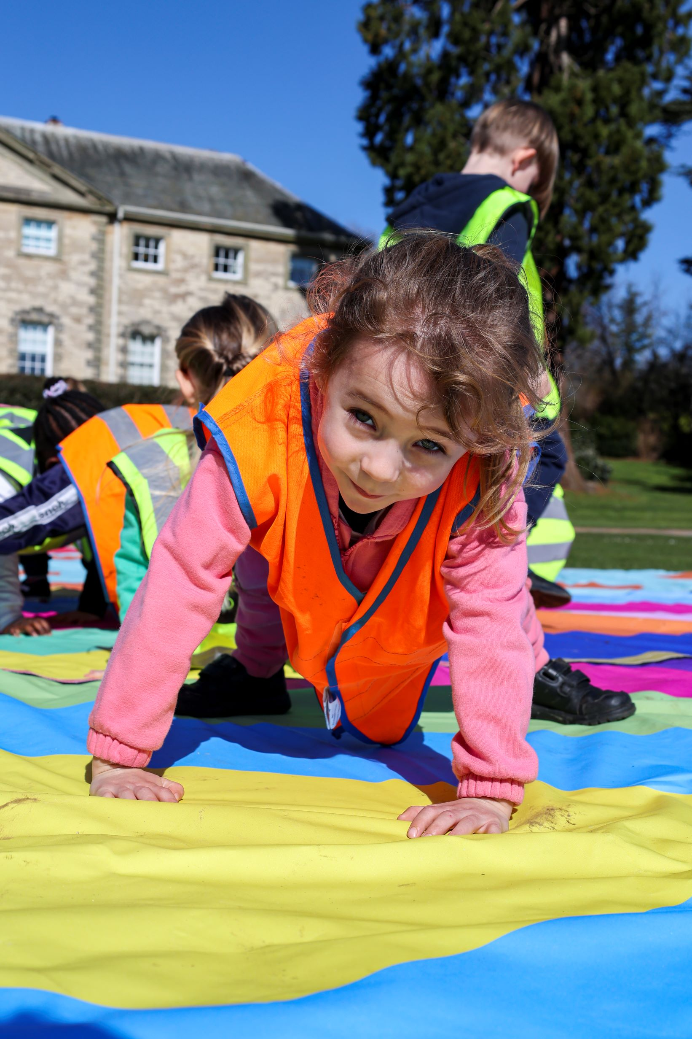
Contents
About the workshop
Itinerary
About Sculpture in the Park
About Print, Pattern, Play
About up & coming Exhibitions
About Volcano Landscapes
Learning Objectives
Learning Outcomes
Top Tips for your visit
To book contact
Learning@comptonverney.org.uk
01926 645 563

Slide 3
About the workshop
Welcome to the Art gallery, this whopper of a day will introduce you to the world of artists and makers at Compton Verney. These multiple workshops involve lots of open-ended resources for making and chances to talk, developing ideas and opinions. We invite discussions: Who can make art? Can I be an artist? What is an Art Gallery? What are artists? Why do they make artwork? What have they made? and more.
Led by our Learning Team, you’ll explore the galleries and investigate different artists and their artworks. You’ll participate in 3 different workshops, each of which is 50 mins in duration and explores different themes. You’ll invent your own artworks in response and be encouraged to shape and develop your ideas using a range of creative media. You’ll experiment with sculpture, printing, drawing and more and develop different techniques for using colour, pattern, form, texture and shape. This is a full day with a variety of experiences and plenty of multi-sensory options to inspire imaginations and creativity.
For more information about each workshop option please continue.
There are four workshops to choose from but please note that the temporary exhibition workshops will vary depending on the timing of your booking and the changing exhibition schedule. If your booking falls in between exhibitions, we will deliver the 3 available options. We are unable to deliver all 4 options at once. Please pick your 3 preferred workshops.
This day is ideal for large groups such as 2-3 classes. 4 classes will need to book over 2 days.
Maximum 35 children per workshop.
£9 per child, supporting adults are free. Minimum charge £180

Slide 4
Itinerary
ART AND DESIGN: WELCOME TO THE ART GALLERY
TEACHERS PACK EYFS & KS1
Timings | Class 1 | Class 2 | Class 3
09:50 | Arrive in coach park, walk up to the galleries
10:00 – 10:30 | Welcome, housekeeping, toilets; drop coats and bags; Walk to first workshop
10:30 – 11:20 | Workshop: EXHIBITION | Workshop: Pattern, Print, Play | Workshop: SCULPTURE IN THE PARK
11:20 – 12:10 | Workshop: SCULPTURE IN THE PARK | Workshop: Exhibition | Workshop: PATTERN,PRINT,PLAY
12:10 – 13:00 | Walk to Picnic area Lunch outside (or Learning rooms if wet) Toilets | Walk to Picnic area Lunch outside (or Learning rooms if wet) Toilets | Walk to Picnic area Lunch outside (or Learning rooms if wet) Toilets
13:00-13:50 | Workshop: PATTERN,PRINT,PLAY | Workshop: Sculpture in the Park | Workshop: EXHIBITION
13:50 | Workshops finish | Workshops finish | Workshops finish
13:50 - 14:15 | Goodbyes, collect bags and walk to the coach | Goodbyes, collect bags and walk to the coach | Goodbyes, collect bags and walk to the coach

Slide 5
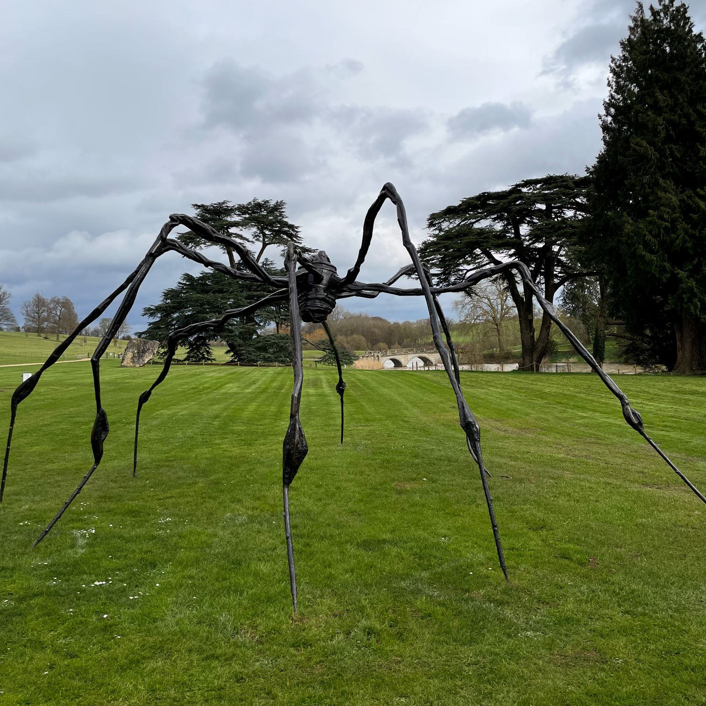
About Sculpture in the Park
ART AND DESIGN: WELCOME TO THE ART GALLERY
TEACHERS PACK EYFS & KS1
The students will visit Compton Verney’s exciting Sculpture in the Park with a member of the Learning Team. They will look at and discuss the sculptures. They will be encouraged to respond to what they see both verbally and physically. The trail will be playful, active and fun!
The children will then have the opportunity to work in small groups to investigate, play and create their own sculpture using a variety of loose part materials.
Please note this workshop Welcome to the Art Gallery highlights and explores sculptures by Louise Bourgeois, and Nicolas Deshayes. We’re not able to see all of the sculptures in the park during this workshop duration.
C OMPT ONVERNE Y. ORG. UK

Slide 6
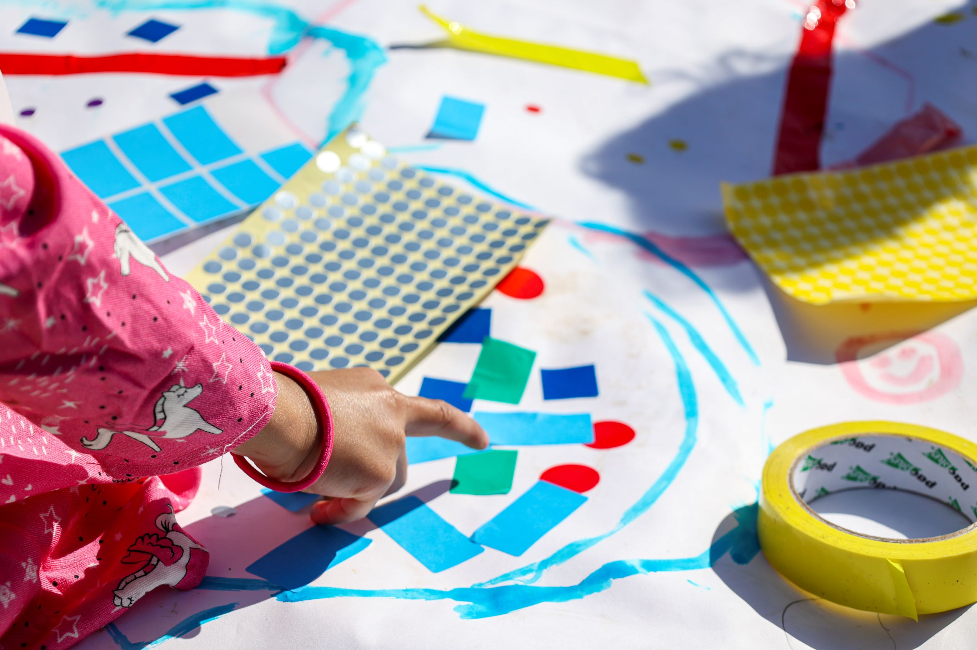
About Pattern, Print, Play
ART & DESIGN: WELCOME TO THE ART GALLERY
TEACHERS PACK EYFS & KS1
Students will discuss shapes, colours and patterns. They will be encouraged to be curious and experiment with making using stamps, stickers, rollers and many more loose parts to create and play with materials. This is about learning through doing and not necessarily about the result at the end. The class will work collaboratively and independently to fill banners full of pattern and colour.
This is an active workshop designed to encourage a range of physical movements, develop fine motor and language skills in a playful and fun setting.
Please note this workshop will include some wet printmaking materials and/or paints, therefore we encourage children not to wear school uniform, aprons are provided.
C OMPT ONVERNE Y. ORG. UK

Slide 7
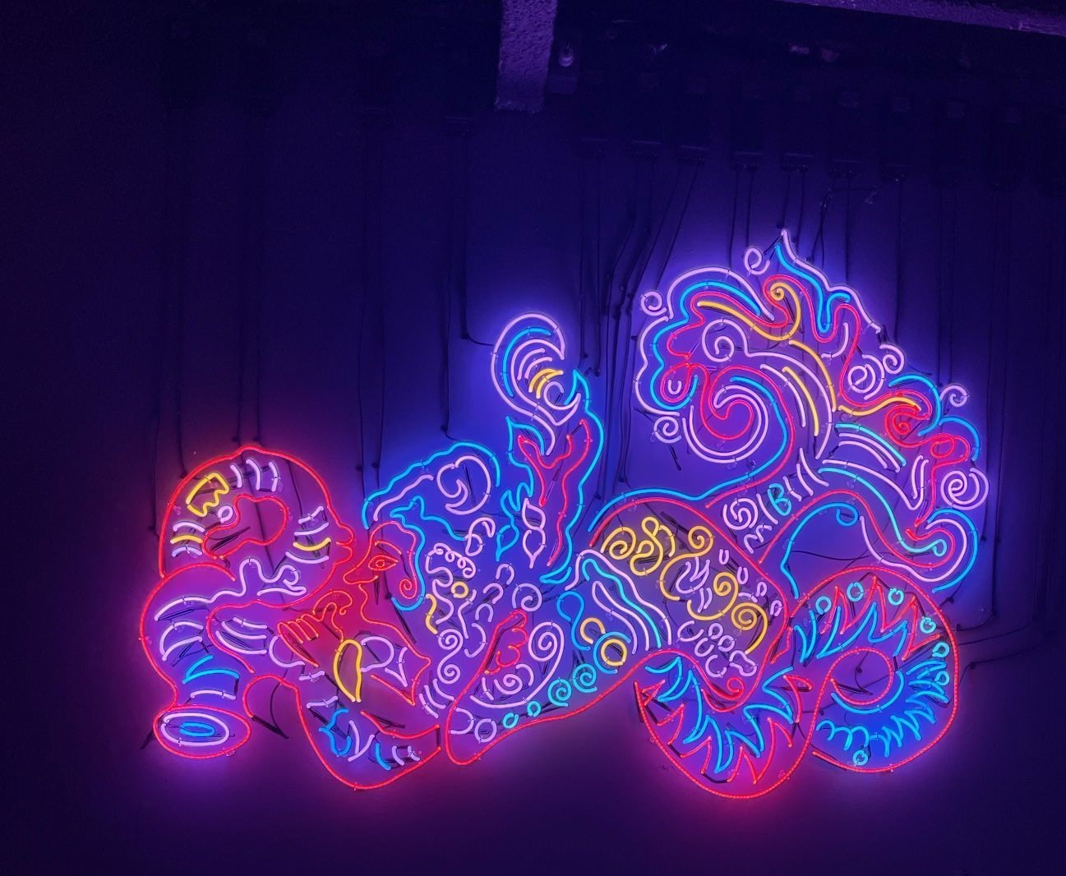
About up & Coming Exhibitions
ART & DESIGN: WELCOME TO THE ART GALLERY
TEACHERS PACK EYFS & KS1
Louise Bourgeois Artist Rooms
6th July – 6th October 2024
Workshop highlights and themes include: storytelling, memories, textiles, spider sculptures, shapes and drawings. You’ll experiment with different drawing materials and create a large collaborative piece.
Chila Kumari Singh Burman
26th October 2024 – 26th January 2025
Workshop highlights and themes include: identity, memories, colour, print, portraits and neon lights. You’ll experiment with creating glow in the dark artworks.
C OMPT ONVERNE Y. ORG. UK

Slide 8
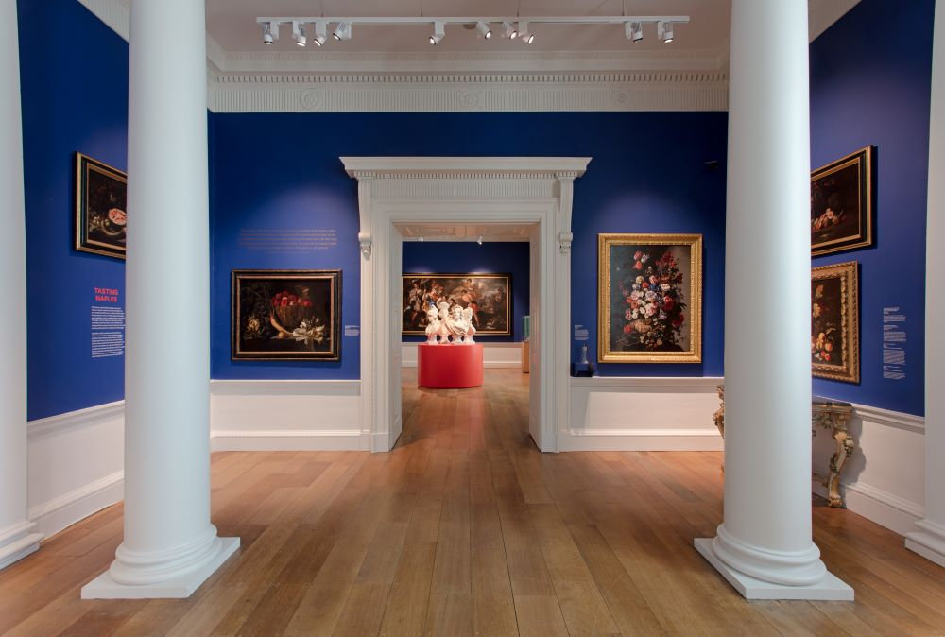
About Volcano Landscapes
ART & DESIGN: WELCOME TO THE ART GALLERY
TEACHERS PACK EYFS & KS1
Can you see the orange glow of lava? What does an erupting volcano smell like? What can you hear?
The Sensing Naples gallery is a multi-sensory space, curated to encourage curiosity and imagination through the different senses, sight, sound, smell and touch. It tells the history and traditions of Neapolitan Art.
The students will be introduced to a painting of volcano Vesuvius erupting at night, they will discuss what they can see and the story that’s unfolding. They will be guided to create a soundscape in response, as if the painting has come alive!
The students will explore the Sensing Naples gallery for inspiration and then in small groups create their own volcano landscape and story using loose part materials, such as fabrics, blocks, papers, sticks and more.
C OMPT ONVERNE Y. ORG. UK

Slide 9
Learning Objectives
ART & DESIGN: WELCOME TO THE ART GALLERY
TEACHERS PACK EYFS & KS1
To visit an art gallery and see a variety of art works.
To engage with an interactive art experience, including using materials to create your own artworks.
To explore and gain knowledge of different types of artworks such as sculptures, paintings and drawings.
To safely use and explore a variety of materials, experimenting with design, texture, colour, form and shape.
To make use of props and materials when playing and creating.
To invent, adapt and recount narratives and stories with peers and their teacher .
To develop artistic skills and creative thinking.
To develop language skills by encouraging the use of names for techniques, materials and types of artworks.
To encourage positive social skills through team building activities.

Slide 10
Learning Outcomes
ART & DESIGN: WELCOME TO THE ART GALLERY
TEACHERS PACK EYFS & KS1
To have been to an art gallery and seen a variety of artworks.
To work with others to build and construct artworks.
Knowledge of different types of artworks and artists, and how they communicate their ideas.
Develop knowledge of materials used in the workshop and practise making with them.
To give their thoughts and opinions on what they have seen, developing creative and imaginative thinking.

Slide 11
Top Tips for planning your visit
Prior to your visit, please make us aware of any students with additional requirements or special needs so we can make all necessary arrangements to support your students.
Your class should be divided into a maximum of 5 groups prior to arrival, with 5 - 6 students in each group with a responsible adult per group.
We encourage all adults to lead by example, that includes getting stuck in and having a go at the activities too!
We’re a cashless site, please contact us in advance if you would like the children to visit the shop.
Students will need to bring a packed lunch, and be supervised during lunch break.
Teacher ratio for EYFS settings and Primary Schools 1:6
Children 12 years old and under must be accompanied by an adult at all times. The supervising adult must be over the age of 18.
We cannot lead workshops or tours without a teacher present.
Teachers are responsible for managing the behaviour of their class
Your group will need appropriate clothing for the weather conditions such as waterproofs, wellington boots or walking boots, long sleeved tops and trousers; sun-cream, sun hats and water bottles. Spare clothing, hats, gloves may be useful.
Outdoor learning workshops take outside in all weather conditions. An indoor alternative will only be sought in the case of extreme weather, this will be discussed with you as weather conditions are monitored closer to your visit.

