Slide 1
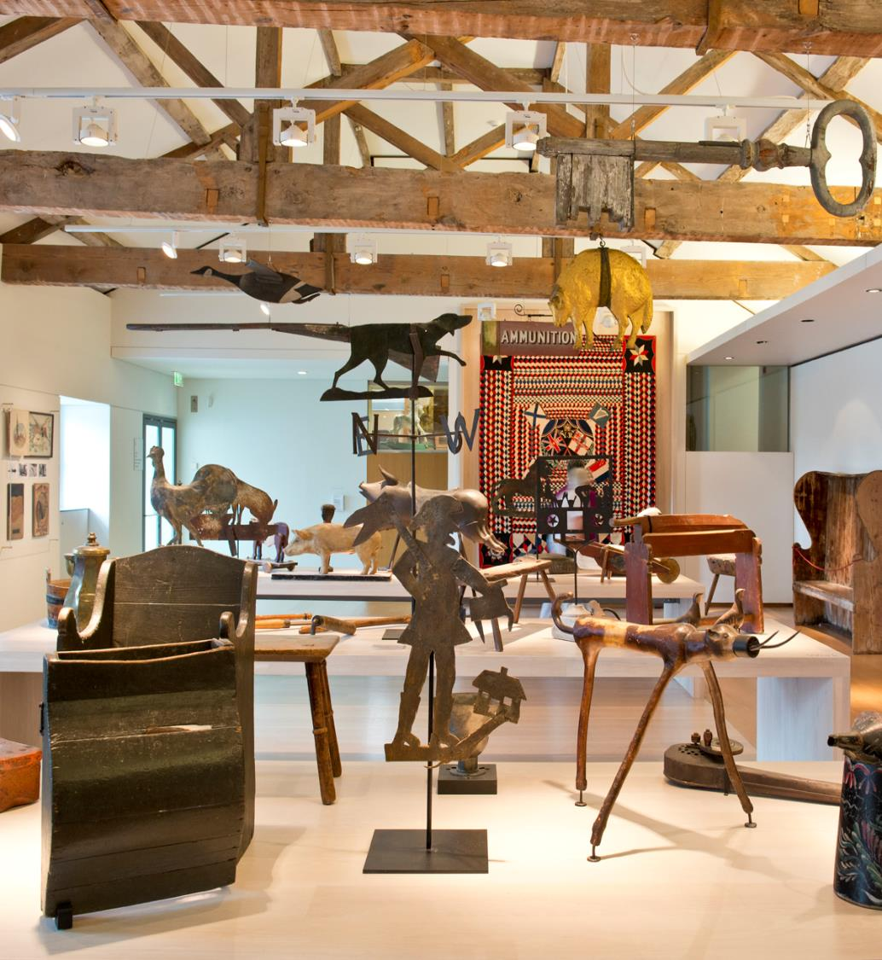
Folk & Function Welcome to the Art Gallery
TEACHERS’ PACK
KEY STAGE 2
C OMPT ONVERNE Y. ORG. UK

Slide 2
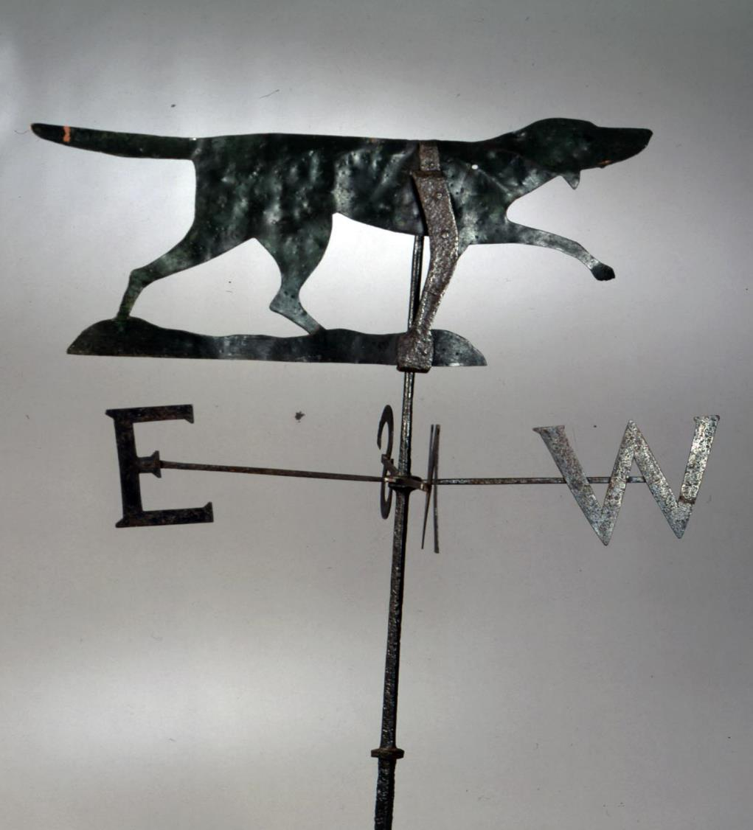
Contents
About Compton Verney
About Folk Art
About the workshop
About up & coming Exhibitions
Learning Objectives
Learning Outcomes
Top Tips for your visit
To book contact
Learning@comptonverney.org.uk
01926 645 563

Slide 3
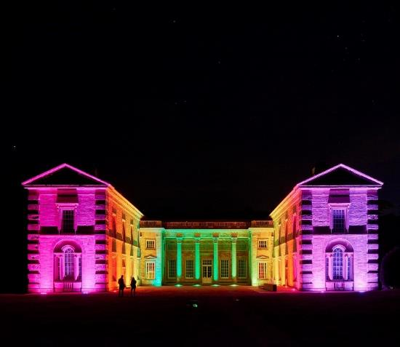
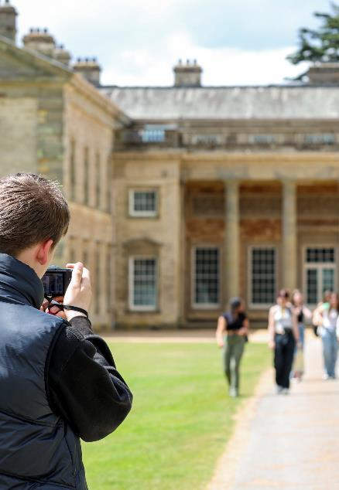
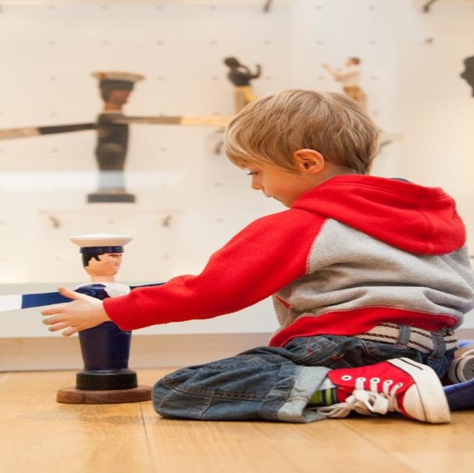
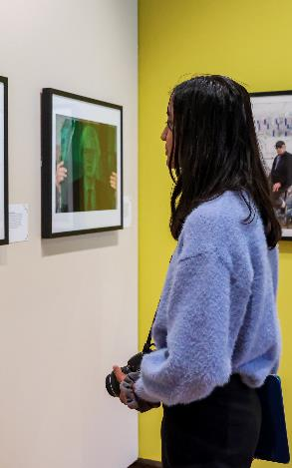
About Compton Verney
ART AND DESIGN: WELCOME TO THE ART GALLERY
TEACHERS PACK KS2
Compton Verney is a national art museum set in 120 acres of fabulous Georgian parkland, only eight miles from Stratford-upon-Avon. We are a registered charity, with the aim of providing an inspiring and entertaining day out for visitors of all ages and backgrounds – whether they have come to see our international art exhibitions, to take part in our wide- ranging activities, to enjoy the diverse features of our extensive landscape, or simply to spend time in our celebrated shop and award-winning restaurant.
Compton Verney seeks to reinforce its position as a nationally and internationally recognised art gallery by continuing to increase visitor numbers and improve the visitor experience, by securing adequate resources to sustain the organisation in the long term, by building our profile locally, regionally, nationally and internationally, and by developing collaborative partnerships with other major institutions and collections.
Compton Verney will celebrate 20 years as an art gallery in 2024.
The education offer is developed and designed by artists, creative and education experts. We aim to deliver high-quality cultural experiences, which inspire the next generation.
The education team have recently been short-listed for the Kids in Museum, Family Friends Museum Award 2023

Slide 4
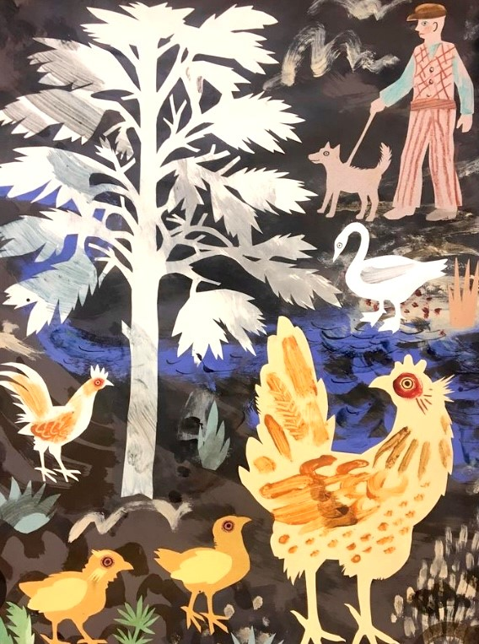
About FOLK ART
ART & DESIGN: WELCOME TO THE ART GALLERY
TEACHERS PACK KS2
Folk Art refers to objects and artworks made by everyday people who didn’t go to art school. Students will explore the objects and artworks on display, their stories and social history. The gallery showcases giant shop signs, children’s toys, a huge tapestry and many more items. Folk Art is quirky, fun and accessible. It highlights the importance of creating for function, tradition and wellbeing.
Students will learn about the function of some of the objects and play with mechanisms that make these objects move.
Inspired by what they discover, students will then use a variety of tools to create their very own moving weather vane.
C OMPT ONVERNE Y. ORG. UK

Slide 5
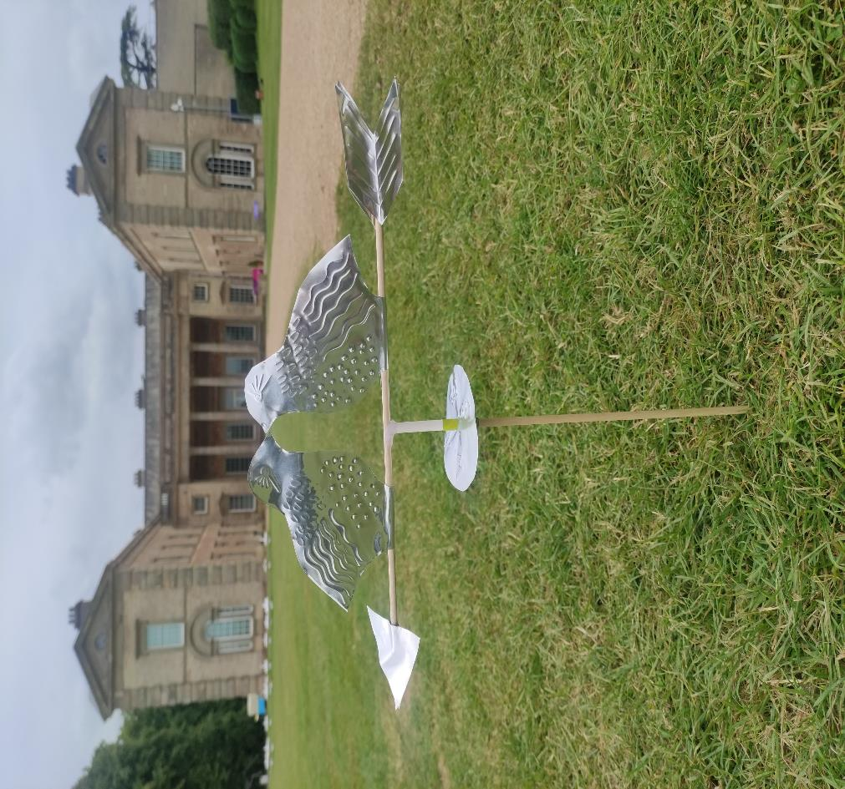
About the workshop
In the morning, students will visit Compton Verney’s British Folk Art exhibition with a member of the Learning Team, where they will explore works from various folk artists, finding out that they were not just nice to look at but also functional.
Students will have the opportunity to handle some of the folk art objects and sketch some of the artworks in the exhibition to use in the afternoon workshop. They will also get to explore and investigate a selection of mechanisms that make objects move.
In the afternoon, students will have the opportunity to experiment with moving parts then create their own weather vane using a variety of design technology materials and tools.
Have a guided tour of the Folk Art exhibition
Handling & observational activities
Testing mechanisms
Students will take part in a practical workshop
Key information
Workshop timings 10am – 2.00pm
Availability – From September 2024
Maximum capacity 35 per individual workshop. We can accommodate 2 classes at once.
How to book
Email: learning@comptonverney.org.uk Tel:01926 645563

Slide 6
Learning Objectives
To explore the art works of 19th and early 20th century craftspeople through original objects and artworks.
To participate in an interactive gallery experience
To develop a repertoire of knowledge, understanding and skills in order to design and make high-quality prototypes and products for a wide range of users.
To understand how to create a weather vane using a range of wood work materials and tools.
Explore and use mechanisms
To understand that wind vanes are used to measure wind direction and be able to tell the wind direction from their own wind vane. Students will understand that wind direction and weather are correlated.
Learning Outcomes
An appreciation of British folk art and life in the late 19th Century.
Knowledge of life, customs and craft skills in the 19th Century.
An understanding of simple mechanisms.
Developed artistic skills, including knowledge of different ways to tell a story with a whirligig.
Create a wind vane to measure wind direction.

Slide 7
Top Tips for planning your visit
Prior to your visit, please make us aware of any students with additional requirements or special needs so we can make all necessary arrangements to support your students.
Your class should be divided into a maximum of 5 groups prior to arrival, with 5 - 6 students in each group with a responsible adult per group.
We encourage all adults to lead by example, that includes getting stuck in and having a go at the activities too!
We’re a cashless site, please contact us in advance if you would like the children to visit the shop.
Students will need to bring a packed lunch, and be supervised during lunch break.
Teacher ratio for EYFS settings and Primary Schools 1:6
Children 12 years old and under must be accompanied by an adult at all times. The supervising adult must be over the age of 18.
We cannot lead workshops or tours without a teacher present.
Teachers are responsible for managing the behaviour of their class
Your group will need appropriate clothing for the weather conditions such as waterproofs, wellington boots or walking boots, long sleeved tops and trousers; sun-cream, sun hats and water bottles. Spare clothing, hats, gloves may be useful.
Outdoor learning workshops take outside in all weather conditions. An indoor alternative will only be sought in the case of extreme weather, this will be discussed with you as weather conditions are monitored closer to your visit.

