Slide 1
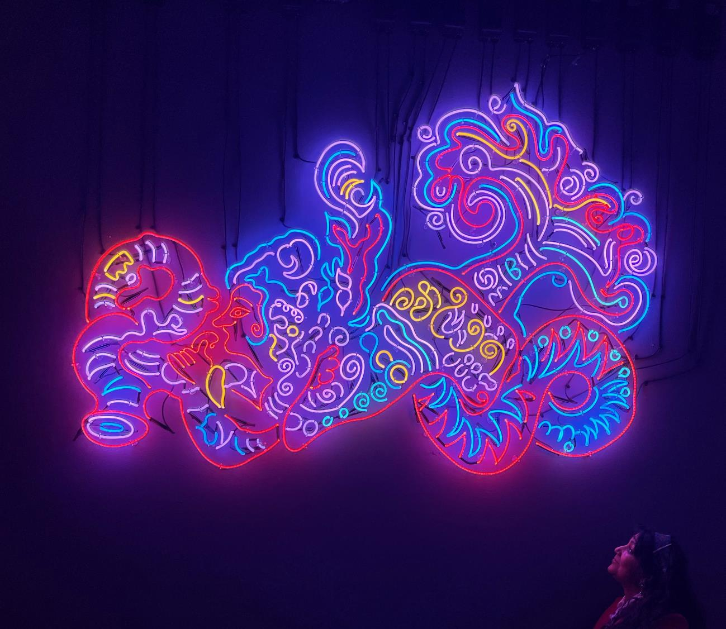
Multi-media
Workshop
TEACHERS PACK
KEY STAGE 2

Slide 2
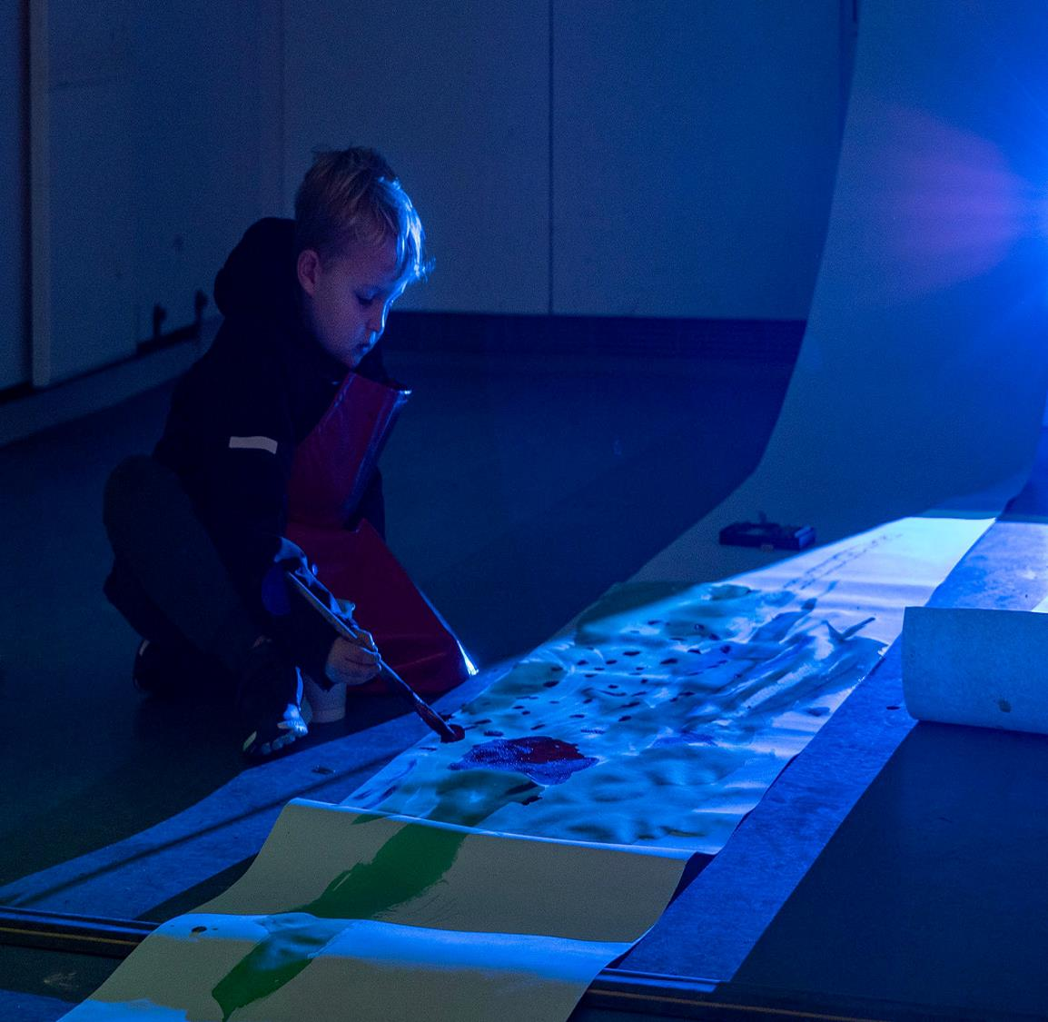
Contents
About Compton Verney
About the workshop
About Chila Kumari Singh Burman
Learning Objectives and Outcomes
Itinerary
Top Tips for your visit
Curriculum Links

Slide 3
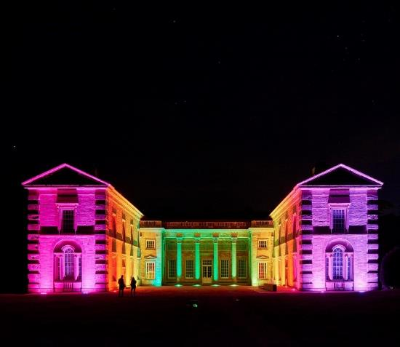
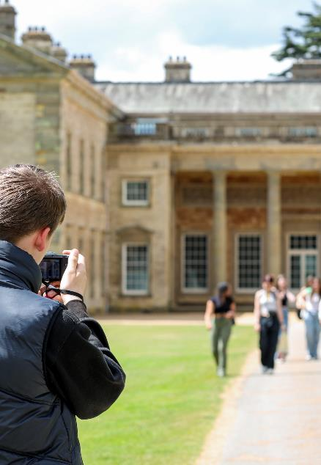
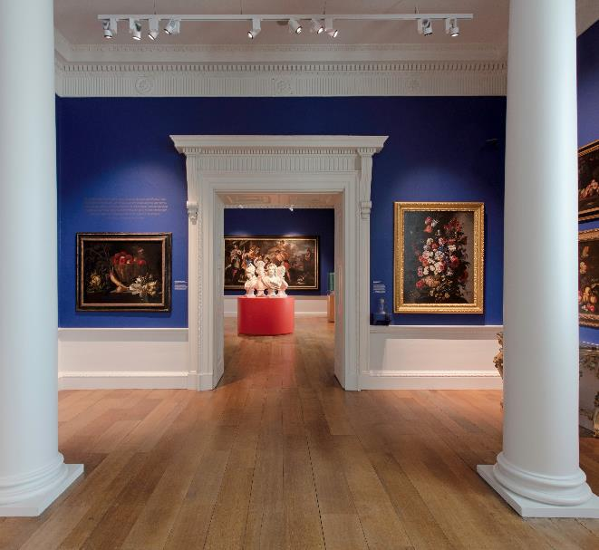
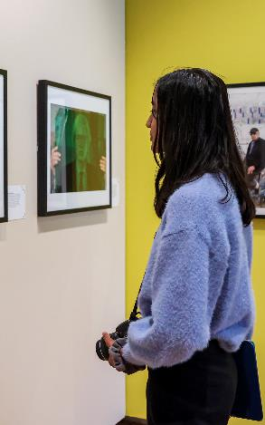
About Compton Verney
Compton Verney is a national art museum set in 120 acres of fabulous Georgian parkland, only eight miles from Stratford-upon-Avon. We are a registered charity, with the aim of providing an inspiring and entertaining day out for visitors of all ages and backgrounds – whether they have come to see our international art exhibitions, to take part in our wide- ranging activities, to enjoy the diverse features of our extensive landscape, or simply to spend time in our celebrated shop and award-winning restaurant.
Compton Verney seeks to reinforce its position as a nationally and internationally recognised art gallery by continuing to increase visitor numbers and improve the visitor experience, by securing adequate resources to sustain the organisation in the long term, by building our profile locally, regionally, nationally and internationally, and by developing collaborative partnerships with other major institutions and collections.
Compton Verney will celebrate 20 years as an art gallery in 2024.
The education offer is developed and designed by artists, creative and education experts. We aim to deliver high-quality cultural experiences, which inspire the next generation.
The education team have recently been short-listed for the Kids in Museum, Family Friends Museum Award 2023

Slide 4
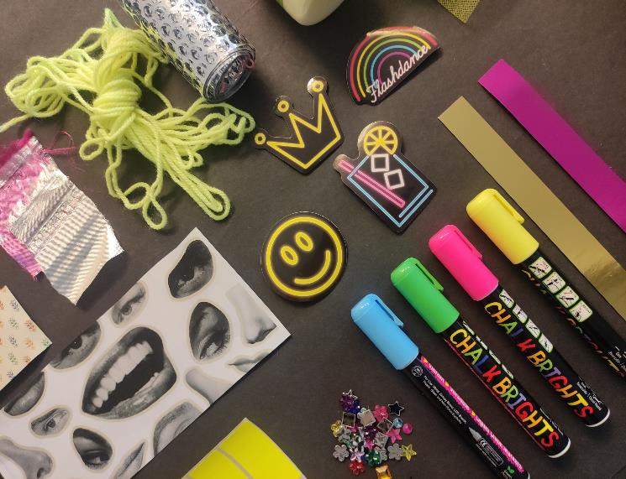
About the workshop
Step into the colourful world of artist Chila Kumari Singh Burman MBE (b.1957), known for her bright neon lights and exciting mixed media artwork.
Join a member of the learning team for a fun and inspiring workshop that starts with a special tour of Burman’s latest exhibition, where you will explore how she combines cultural patterns, popular culture images and bold neon colours to create amazing art.
Our friendly team will help you understand how Burman expresses her identity and heritage through her unique creations.
Then you will head to our Learning Centre to make your own special piece of mixed media art using a variety of exciting and unusual materials and techniques to create your very own art work.
Have a guided tour of the Chila Kumari Singh Burman collection
Observational activities in the exhibition
Students will take part in a practical workshop
Key information
Workshop timings 10am – 2.00pm
Availability – October - January
Maximum 35 children per workshop.
£9 per child, supporting adults are free. Minimum charge £180
How to book
Email: learning@comptonverney.org.uk Tel:01926 645563

Slide 5
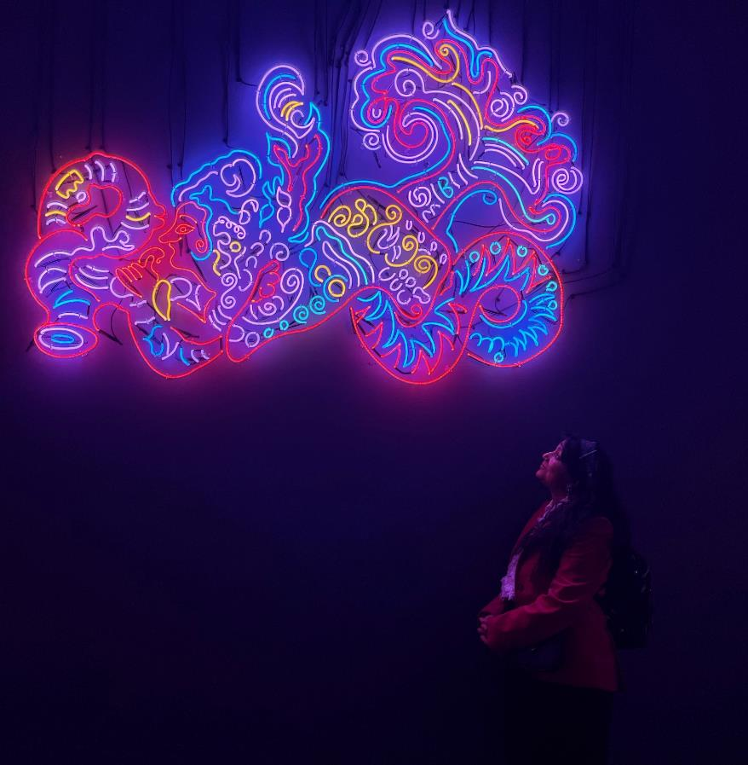
Chila Kumari Singh Burman
Compton Verney is excited to present a new solo exhibition by one of the leading contemporary artists working in the UK today – Chila Kumari Singh Burman MBE (b.1957).
Opening in the autumn, the exhibition will present new and recent neon and sculptural works which have not been shown before, alongside earlier prints, collages and films. The works encompass a 40-year period in which Burman has explored her Punjabi cultural identity, feminism, and working class Liverpudlian upbringing, amongst other themes.
A large-scale intervention across the façade of the house, comprised of Burman’s signature neons, will accompany the exhibition.
Image: Chila Kumari Singh Burman, Mermaid, 2022, silicone neon. Courtesy the artist

Slide 6
Learning Objectives
To explore personal identity through art.
To understand the use of colour, especially neon, in expressing emotions and individuality.
To learn a variety of collage techniques.
Learning Outcomes
To understand how artists use a variety of techniques and ideas to express their ideas.
To know the techniques of mixed media art and how to combine different materials such as paper, markers and found objects to create cohesive artwork.
To create a piece of art work that expresses identity using images, colour and collage techniques.
Understand the visual impact of different colours.

Slide 7
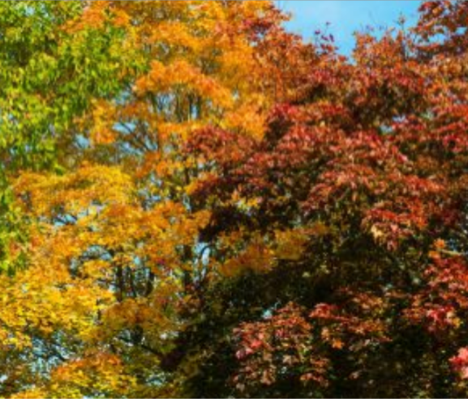
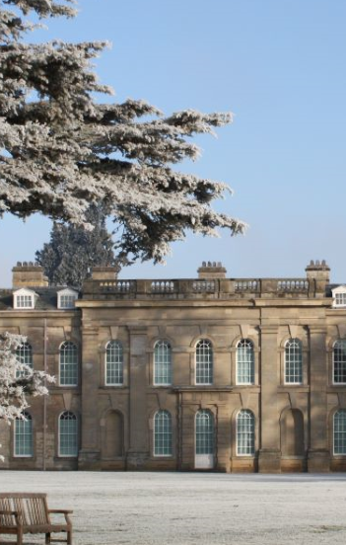
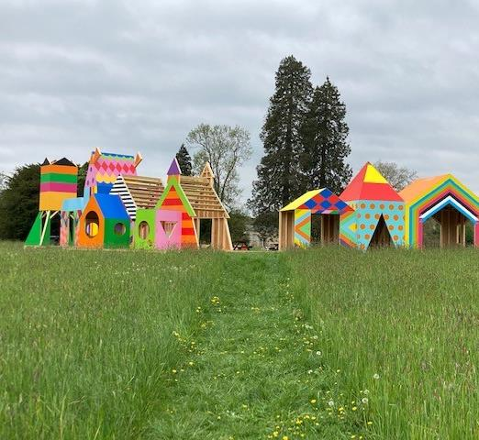
Itinerary
10am – 10.15am
Welcome and introduction at the Learning Centre
10.15am – 12.00pm
Students visit the Chila Kumari Singh Burman exhibition with the learning team. And they take part in a series of observational activities.
12:00pm – 12.30pm
Lunch – outside or learning studio depending on the weather.
12.30pm – 1:45pm
Students will use a variety of materials to design and make their own new mixed-media artwork.
1:45pm – 2.00pm
Plenary at the learning studio. Students and teachers review their day and reflect upon their time as artists for the day.

Slide 8
Top Tips
Planning your visit and making the most of the day
Your group will need appropriate clothing that they don’t mind getting messy.
Prior to your visit please make us aware of any students with additional requirements or special needs so we can make all necessary arrangements to support your students.
We recommend staff bring a camera to record activities.
We’re a cashless site, please contact us in advance if you would like the children to visit the shop.
Students will need to bring a packed lunch, and be supervised during lunch break.
We encourage all adults to lead by example, that includes getting stuck in and having a go at the activities too!
Teacher Ratio for Primary School 1:6 and Secondary School 1:15
Children 12 years old and under must be accompanied by an adult at all times. The supervising adult must be over the age of 18.
We cannot lead workshops or tours without a teacher present.
On arrival coaches can drop off in the carpark. Coaches cannot drop off at the gallery owing to weight restrictions on the Upper Bridge.
When arriving please enter through the gate to the left of the welcome centre. The walk from the car park will take approximately 5-7 minutes. A member of the Learning Team will meet you outside the gallery.

Slide 9
Curriculum Links
Subject | Curriculum Link
ART | · Produce creative work, exploring their ideas and recording their experiences. · Become proficient in collage techniques. · Evaluate and analyse creative works using the language of art, craft and design. · Know about great artists, craft makers and designers, and understand the historical and cultural development of their art forms. · To use a range of techniques to record their observations in sketchbooks, journals and other media as a basis for exploring their ideas. · To use a range of techniques and media. · To increase their proficiency in the handling of different materials. · To analyse and evaluate their own work, and that of others, in order to strengthen the visual impact or applications of their work. · Know about the history of art including periods, styles and major movements.
PSHE | · Provide opportunities for pupils to develop positive attitudes and values and to reflect and relate their learning to their own experience. · Develop young people’s understanding and appreciation of diversity, to promote shared values and to challenge racism and discrimination. · Use research and exploration, such as the study of different cultures, to identify and understand user needs .

